Slide 1

Oracle Database 10g: SQL Fundamentals II
Electronic Presentation
D17111GC11
Production 1.1 August 2004 D39754
®

Slide 2

Author
Copyright © 2004, Oracle. All rights reserved.
Priya Vennapusa
This documentation contains proprietary information of Oracle Corporation. It is provided under a license agreement containing restrictions on use and disclosure and is also protected by copyright law. Reverse engineering of the software is prohibited. If this documentation is delivered to a U.S.
Technical Contributors and Reviewers
Government Agency of the Department of Defense, then it is delivered with Restricted Rights and the following legend is applicable:
Brian Boxx
Restricted Rights Legend
Andrew Brannigan Zarko Cesljas
Use, duplication or disclosure by the Government is subject to restrictions for commercial computer software and shall be deemed to be Restricted Rights software under Federal law, as set forth in subparagraph (c)(1)(ii) of DFARS 252.227-7013, Rights in Technical Data and Computer Software (October 1988).
Marjolein Dekkers Joel Goodman
Nancy Greenberg Stefan Grenstad Rosita Hanoman Angelika Krupp
This material or any portion of it may not be copied in any form or by any means without the express prior written permission of the Education Products group of Oracle Corporation. Any other copying is a violation of copyright law and may result in civil and/or criminal penalties.
If this documentation is delivered to a U.S. Government Agency not within the Department of Defense, then it is delivered with “Restricted Rights,” as defined in FAR 52.227-14, Rights in Data- General, including Alternate III (June 1987).
Christopher Lawless Malika Marghadi Priya Nathan
The information in this document is subject to change without notice. If you find any problems in the documentation, please report them in writing to Worldwide Education Services, Oracle Corporation, 500Oracle Parkway, Box SB-6, Redwood Shores, CA 94065. Oracle Corporation does not warrant that this document is error-free.
Ruediger Steffan
Publisher
Oracle and all references to Oracle Products are trademarks or registered trademarks of Oracle Corporation.
Hemachitra K
All other products or company names are used for identification purposes only, and may be trademarks of their respective owners.

Slide 3

Introduction
Copyright © 2004, Oracle. All rights reserved.

Slide 4

Objectives
After completing this lesson, you should be able to do the following:
•
List the course objectives
•
Describe the sample tables used in the course
Copyright © 2004, Oracle. All rights reserved.

Slide 5
Course Objectives
After completing this course, you should be able to do the following:
• Use advanced SQL data retrieval techniques to
retrieve data from database tables
• Apply advanced techniques in a practice that
simulates real life
Copyright © 2004, Oracle. All rights reserved.

Slide 6
Course Overview
In this course, you will use advanced SQL data retrieval techniques such as:
•
Datetime functions
•
ROLLUP, CUBE operators, and GROUPING SETS
•
Hierarchical queries
•
Correlated subqueries
•
Multitable inserts
•
Merge operation
•
External tables
•
Regular expression usage
Copyright © 2004, Oracle. All rights reserved.

Slide 7
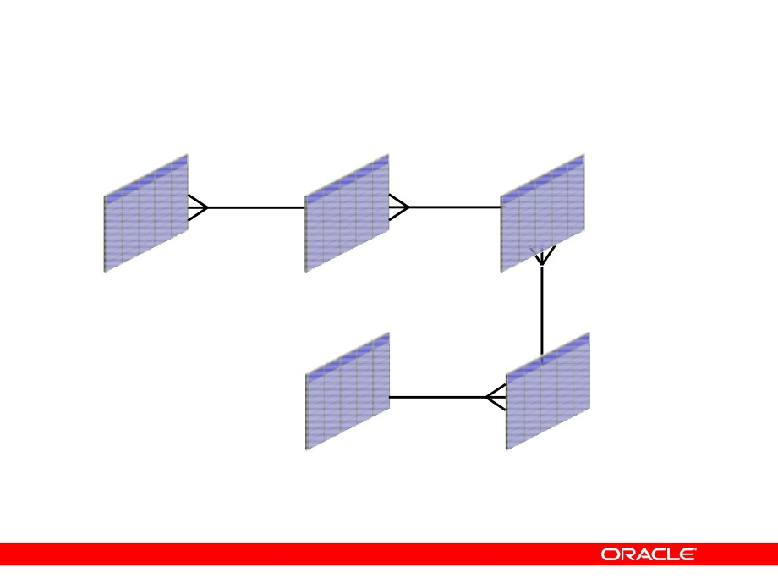
Course Application
EMPLOYEES
DEPARTMENTS
LOCATIONS
REGIONS
COUNTRIES
Copyright © 2004, Oracle. All rights reserved.

Slide 8
Summary
In this lesson, you should have learned the following:
•
The course objectives
•
The sample tables used in the course
Copyright © 2004, Oracle. All rights reserved.

Slide 9

Controlling User Access
Copyright © 2004, Oracle. All rights reserved.

Slide 10

Objectives
After completing this lesson, you should be able to do the following:
•
Differentiate system privileges from object
privileges
•
Grant privileges on tables
•
View privileges in the data dictionary
•
Grant roles
•
Distinguish between privileges and roles
Copyright © 2004, Oracle. All rights reserved.

Slide 11
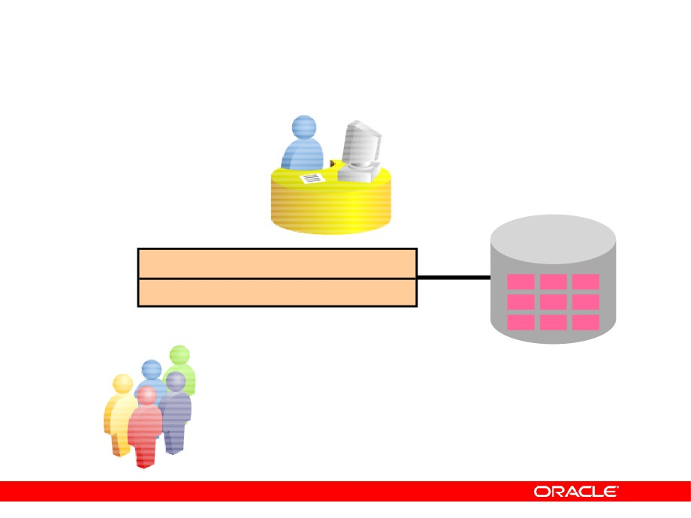
Controlling User Access
Database
administrator
Username and password Privileges
Users
Copyright © 2004, Oracle. All rights reserved.

Slide 12
Privileges
•
Database security:
- System security
- Data security
•
System privileges: Gaining access to the database
•
Object privileges: Manipulating the content of the
database objects
• Schemas: Collection of objects such as tables,
views, and sequences
Copyright © 2004, Oracle. All rights reserved.

Slide 13
System Privileges
•
More than 100 privileges are available.
•
The database administrator has high-level system
privileges for tasks such as:
- Creating new users
- Removing users
- Removing tables
- Backing up tables
Copyright © 2004, Oracle. All rights reserved.

Slide 14
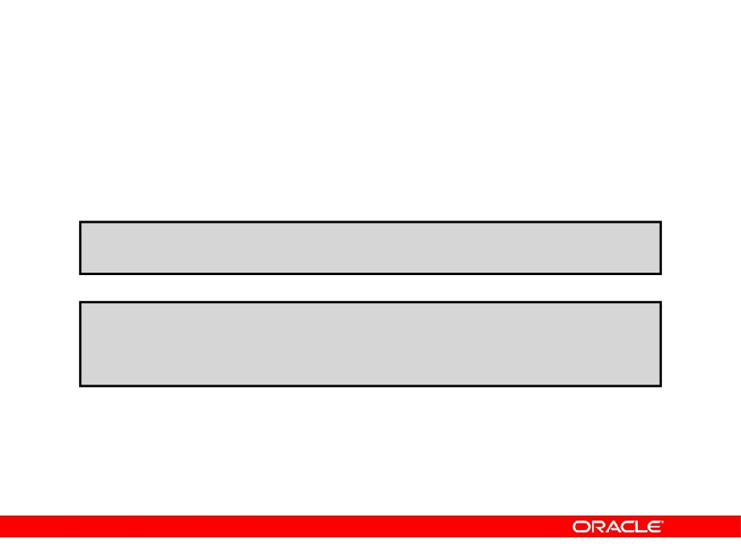
Creating Users
The DBA creates users with the CREATE USER statement.
CREATE USER user
IDENTIFIED BY password;
CREATE USER HR
IDENTIFIED BY
HR;
User created.
Copyright © 2004, Oracle. All rights reserved.

Slide 15
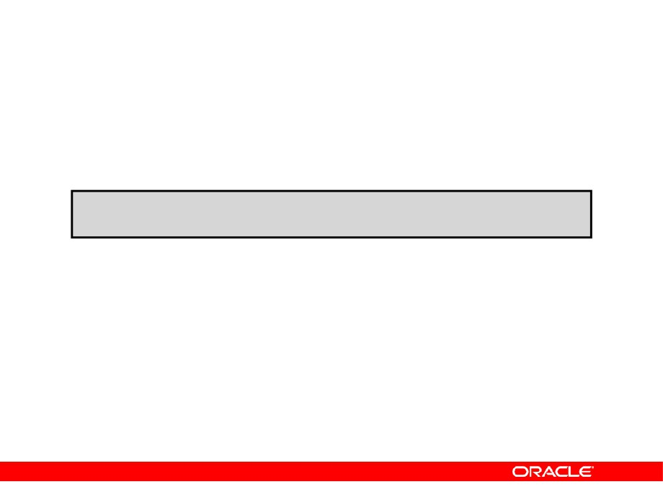
User System Privileges
• After a user is created, the DBA can grant specific
system privileges to that user.
GRANT privilege [, privilege...]
TO user [, user| role, PUBLIC...];
• An application developer, for example, may have
the following system privileges:
- CREATE SESSION
- CREATE TABLE
- CREATE SEQUENCE
- CREATE VIEW
- CREATE PROCEDURE
Copyright © 2004, Oracle. All rights reserved.

Slide 16
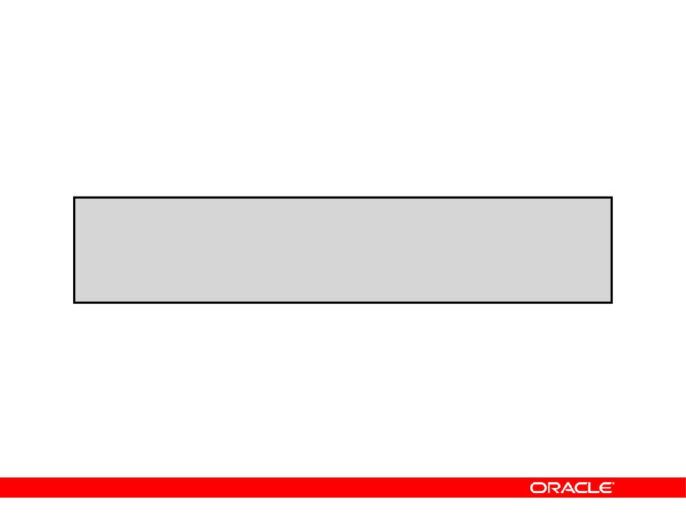
Granting System Privileges
The DBA can grant specific system privileges to a user.
GRANT create session, create table, create sequence, create view
TO
scott;
Grant succeeded.
Copyright © 2004, Oracle. All rights reserved.

Slide 17
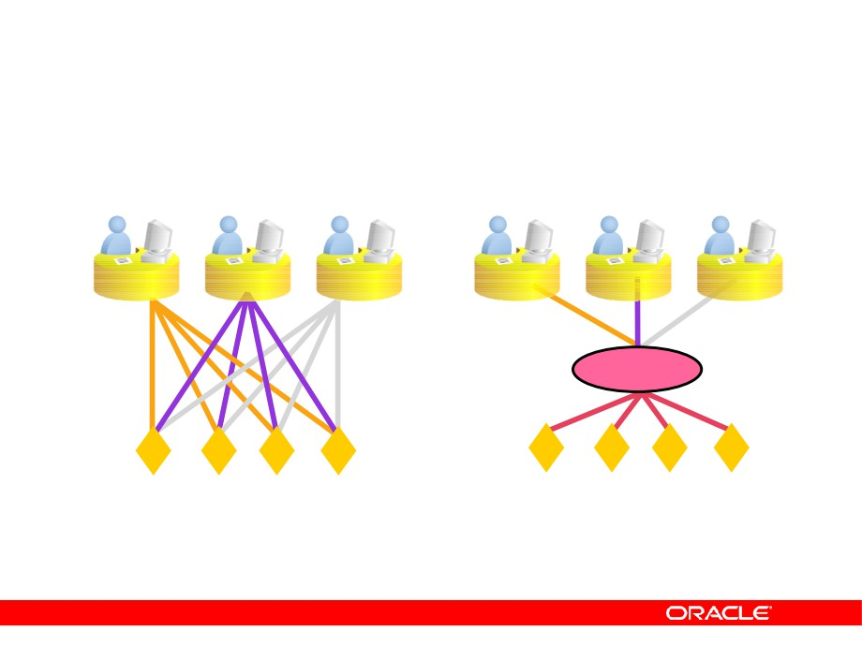
What Is a Role?
Users
Manager
Privileges
Allocating privileges
Allocating privileges
without a role
with a role
Copyright © 2004, Oracle. All rights reserved.

Slide 18
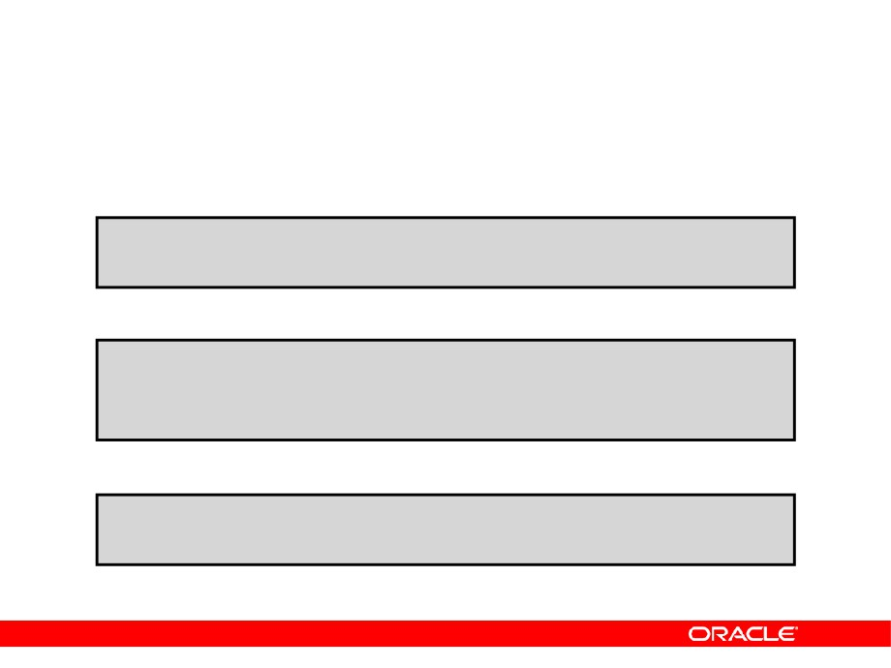
Creating and Granting Privileges to a Role
•
Create a role
CREATE ROLE manager;
Role created.
• Grant privileges to a role
GRANT create table, create view TO manager;
Grant succeeded.
•
Grant a role to users
GRANT manager TO DE HAAN, KOCHHAR;
Grant succeeded.
Copyright © 2004, Oracle. All rights reserved.

Slide 19
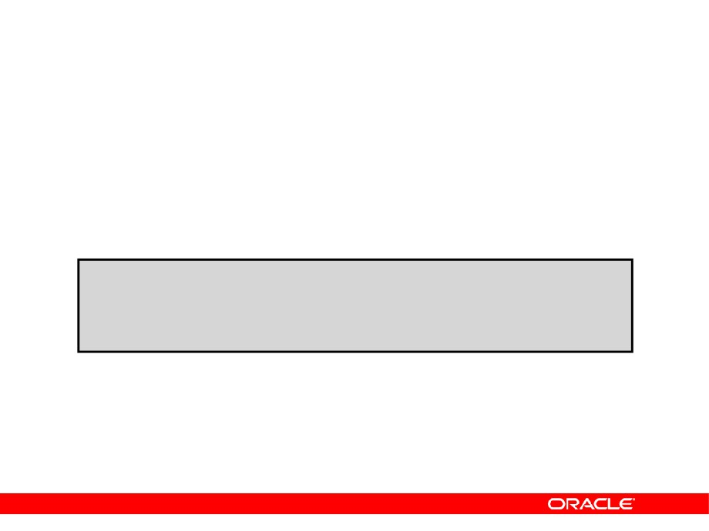
Changing Your Password
• The DBA creates your user account and initializes
your password.
• You can change your password by using the
ALTER USER statement.
ALTER USER HR
IDENTIFIED BY employ;
User altered.
Copyright © 2004, Oracle. All rights reserved.

Slide 20
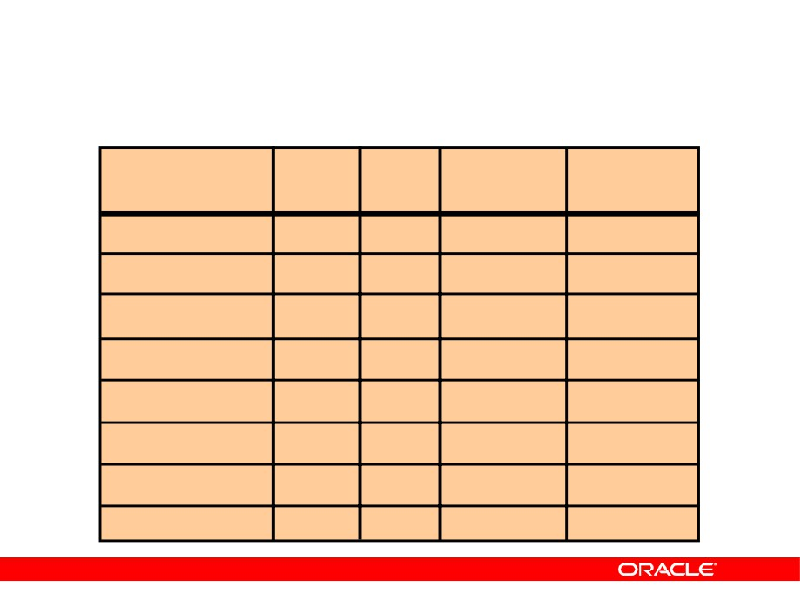
Object Privileges
Object
Privilege
Table
View
Sequence
Procedure
ALTER
√
√
DELETE
√
√
EXECUTE
√
INDEX
√
INSERT
√
√
REFERENCES
√
SELECT
√
√
√
UPDATE
√
√
Copyright © 2004, Oracle. All rights reserved.

Slide 21
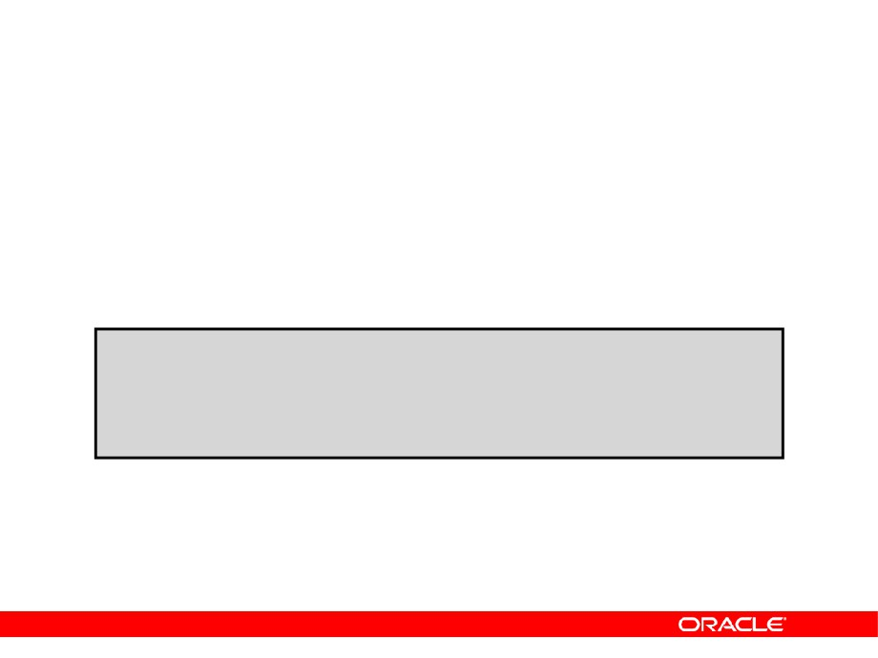
Object Privileges
•
Object privileges vary from object to object.
•
An owner has all the privileges on the object.
•
An owner can give specific privileges on that
owner’s object.
GRANT
object_priv [(columns)]
ON
object
TO
{user|role|PUBLIC}
[WITH GRANT OPTION];
Copyright © 2004, Oracle. All rights reserved.

Slide 22
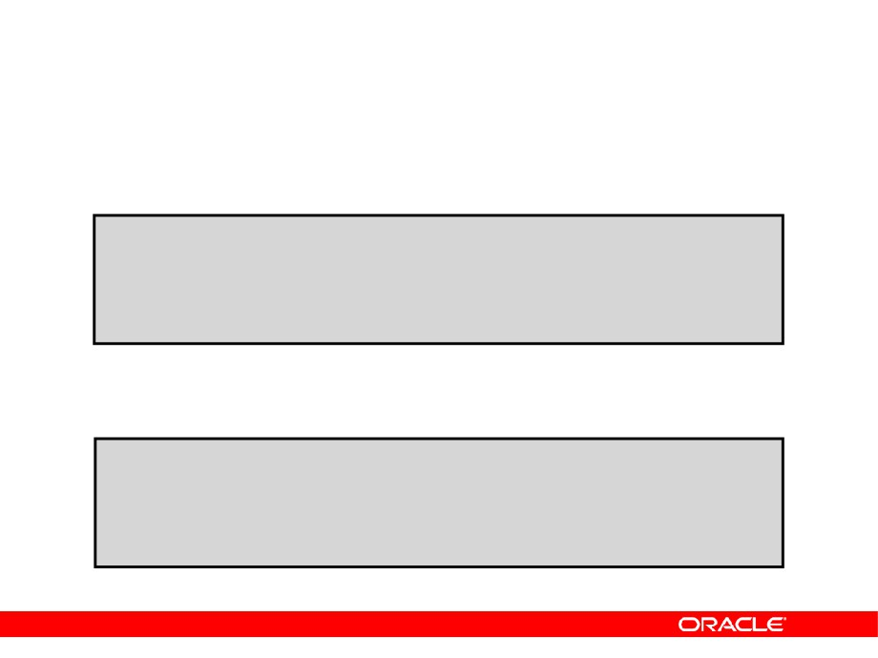
Granting Object Privileges
•
Grant query privileges on the EMPLOYEES table.
GRANT select
ON
employees
TO
sue, rich;
Grant succeeded.
• Grant privileges to update specific columns to
users and roles.
GRANT update (department_name, location_id)
ON
departments
TO
scott, manager;
Grant succeeded.
Copyright © 2004, Oracle. All rights reserved.

Slide 23
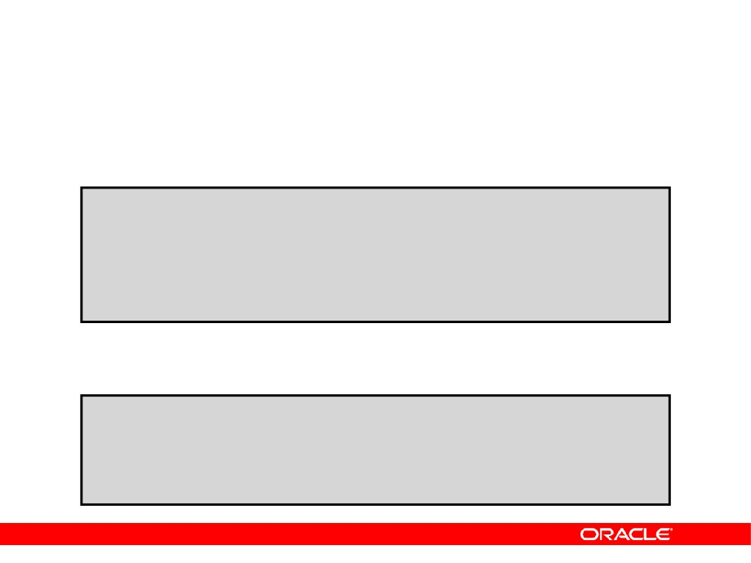
Passing On Your Privileges
•
Give a user authority to pass along privileges.
GRANT select, insert
ON
departments
TO
scott
WITH
GRANT OPTION;
Grant succeeded.
•
Allow all users on the system to query data from
Alice’s DEPARTMENTS table.
GRANT select
ON
alice.departments
TO
PUBLIC;
Grant succeeded.
Copyright © 2004, Oracle. All rights reserved.

Slide 24
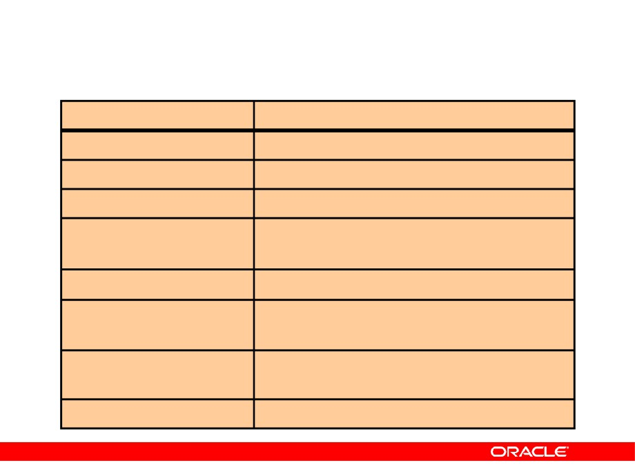
Confirming Privileges Granted
Data Dictionary View
Description
ROLE_SYS_PRIVS
System privileges granted to roles
ROLE_TAB_PRIVS
Table privileges granted to roles
USER_ROLE_PRIVS
Roles accessible by the user
USER_TAB_PRIVS_MADE Object privileges granted on the user’s
objects
USER_TAB_PRIVS_RECD Object privileges granted to the user USER_COL_PRIVS_MADEObject privileges granted on the
columns of the user’s objects
USER_COL_PRIVS_RECD Object privileges granted to the user on
specific columns
USER_SYS_PRIVS
System privileges granted to the user
Copyright © 2004, Oracle. All rights reserved.

Slide 25
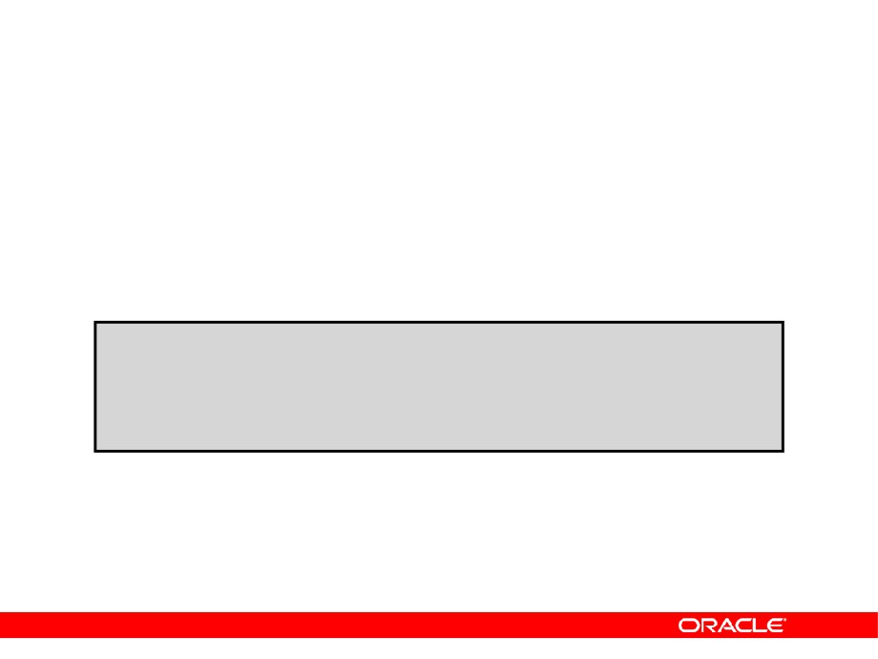
Revoking Object Privileges
• You use the REVOKE statement to revoke
privileges granted to other users.
•
Privileges granted to others through the WITH
GRANT OPTION clause are also revoked.
REVOKE {privilege [, privilege...]|ALL}
ON
object
FROM
{user[, user...]|role|PUBLIC}
[CASCADE CONSTRAINTS];
Copyright © 2004, Oracle. All rights reserved.

Slide 26
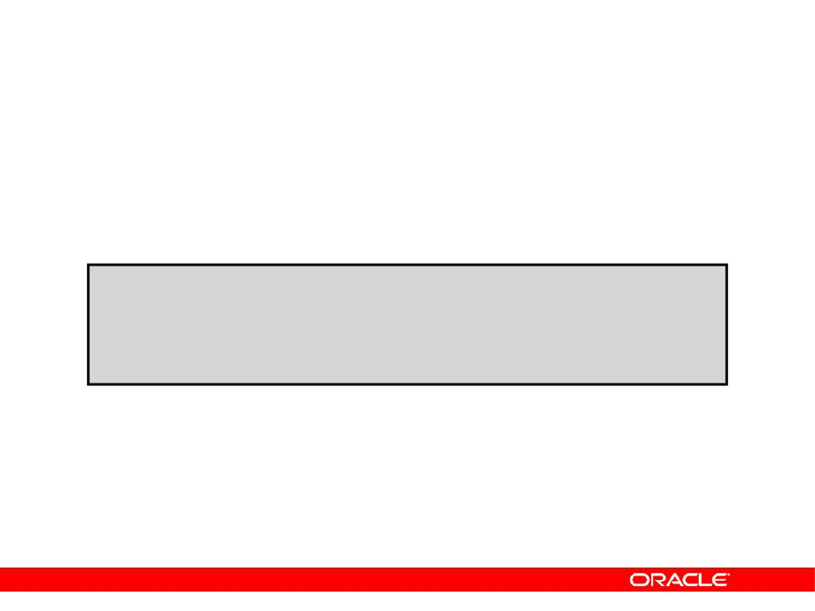
Revoking Object Privileges
As user Alice, revoke the SELECT and INSERT
privileges given to user Scott on the DEPARTMENTS table.
REVOKE select, insert
ON
departments
FROM
scott;
Revoke succeeded.
Copyright © 2004, Oracle. All rights reserved.

Slide 27
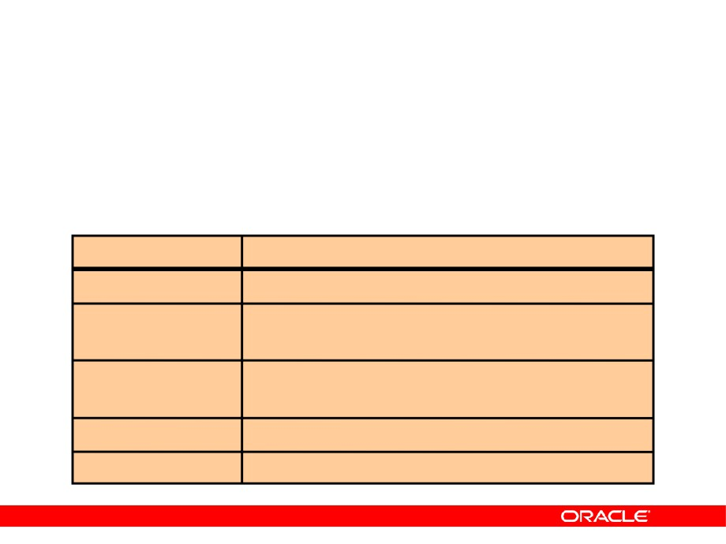
Summary
In this lesson, you should have learned about
statements that control access to the database and database objects.
Statement
Action
CREATE USER
Creates a user (usually performed by a DBA)
GRANT
Gives other users privileges to access the
objects
CREATE ROLE
Creates a collection of privileges (usually
performed by a DBA)
ALTER USER
Changes a user’s password
REVOKE
Removes privileges on an object from users
Copyright © 2004, Oracle. All rights reserved.

Slide 28
Practice 1: Overview
This practice covers the following topics:
•
Granting other users privileges to your table
•
Modifying another user’s table through the
privileges granted to you
•
Creating a synonym
•
Querying the data dictionary views related to
privileges
Copyright © 2004, Oracle. All rights reserved.

Slide 29

Manage Schema Objects
Copyright © 2004, Oracle. All rights reserved.

Slide 30
Objectives
After completing this lesson, you should be able to do the following:
•
Add constraints
•
Create indexes
•
Create indexes using the CREATE TABLE
statement
•
Creating function-based indexes
•
Drop columns and set column UNUSED
•
Perform FLASHBACK operations
•
Create and use external tables
Copyright © 2004, Oracle. All rights reserved.

Slide 31
The ALTER TABLE Statement
Use the ALTER TABLE statement to:
•
Add a new column
•
Modify an existing column
•
Define a default value for the new column
•
Drop a column
Copyright © 2004, Oracle. All rights reserved.

Slide 32
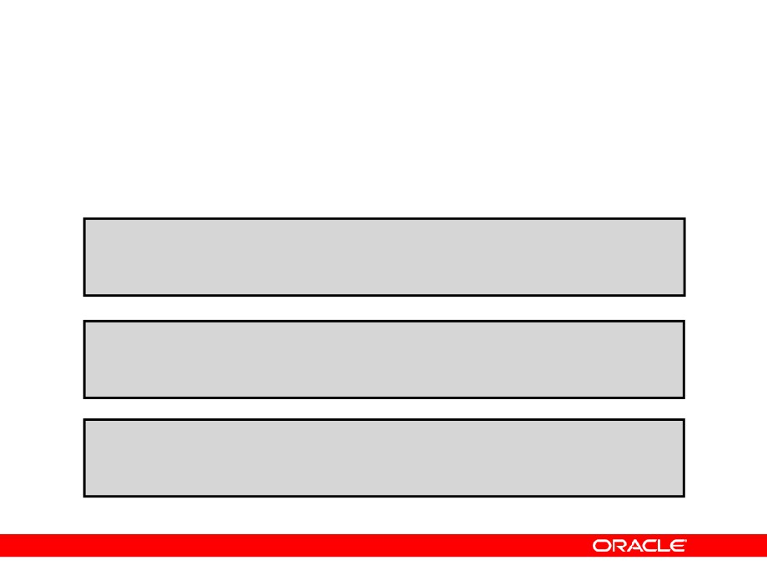
The ALTER TABLE Statement
Use the ALTER TABLE statement to add, modify, or drop columns.
ALTER TABLE table
ADD
(column datatype [DEFAULT expr]
[, column datatype]...);
ALTER TABLE table
MODIFY
(column datatype [DEFAULT expr]
[, column datatype]...);
ALTER TABLE table
DROP
(column);
Copyright © 2004, Oracle. All rights reserved.

Slide 33
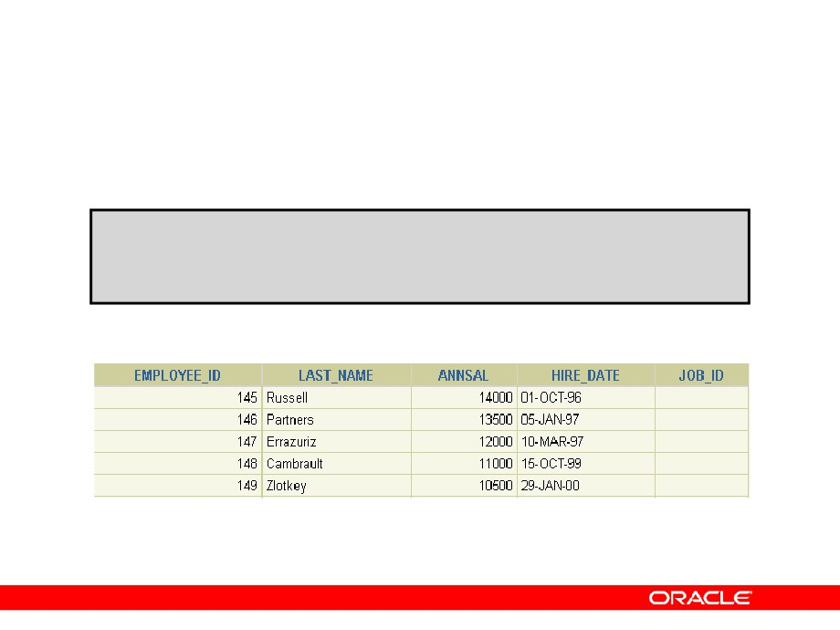
Adding a Column
• You use the ADD clause to add columns.
ALTER TABLE dept80
ADD
(job_id VARCHAR2(9));
Table altered.
• The new column becomes the last column.
Copyright © 2004, Oracle. All rights reserved.

Slide 34
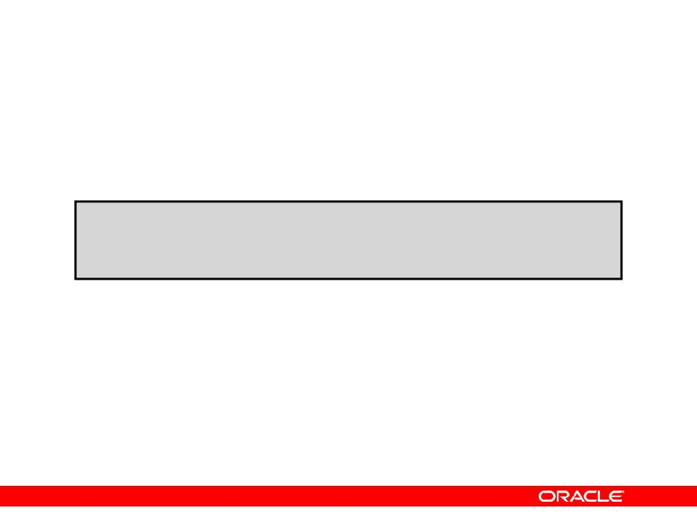
Modifying a Column
• You can change a column’s data type, size, and
default value.
ALTER TABLE dept80
MODIFY
(last_name VARCHAR2(30));
Table altered.
• A change to the default value affects only
subsequent insertions to the table.
Copyright © 2004, Oracle. All rights reserved.

Slide 35
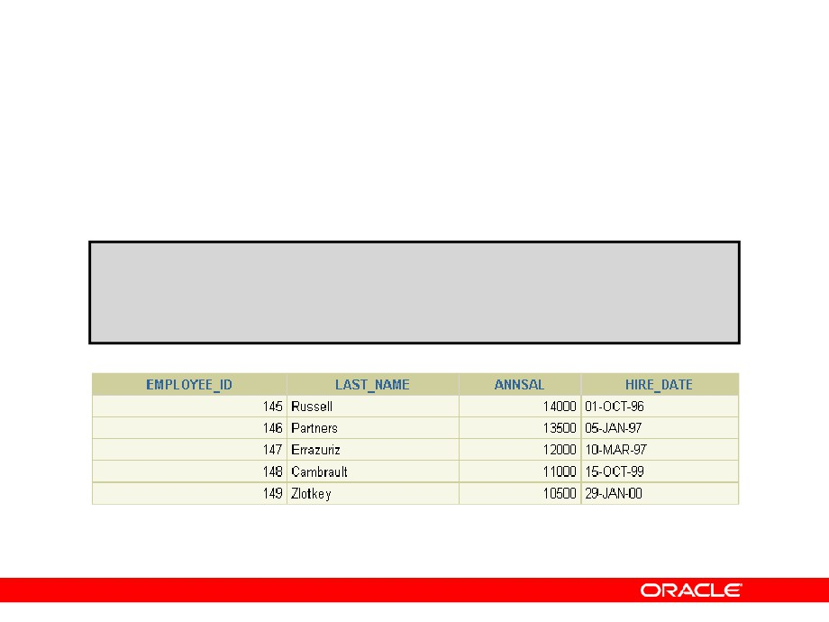
Dropping a Column
Use the DROP COLUMN clause to drop columns you no longer need from the table.
ALTER TABLE dept80 DROP COLUMN job_id;
Table altered.
Copyright © 2004, Oracle. All rights reserved.

Slide 36
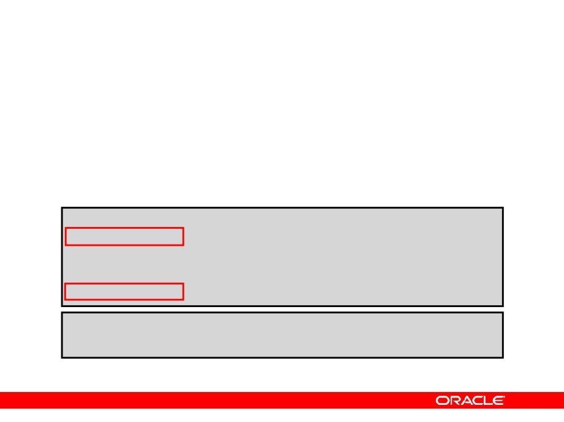
The SET UNUSED Option
• You use the SET UNUSED option to mark one or
more columns as unused.
•
You use the DROP UNUSED COLUMNS option to
remove the columns that are marked as unused.
ALTER TABLE
<table_name>
SET
UNUSED(<column_name>);
OR
ALTER TABLE
<table_name>
SET
UNUSED
COLUMN <column_name>;
ALTER TABLE <table_name> DROP UNUSED COLUMNS;
Copyright © 2004, Oracle. All rights reserved.

Slide 37
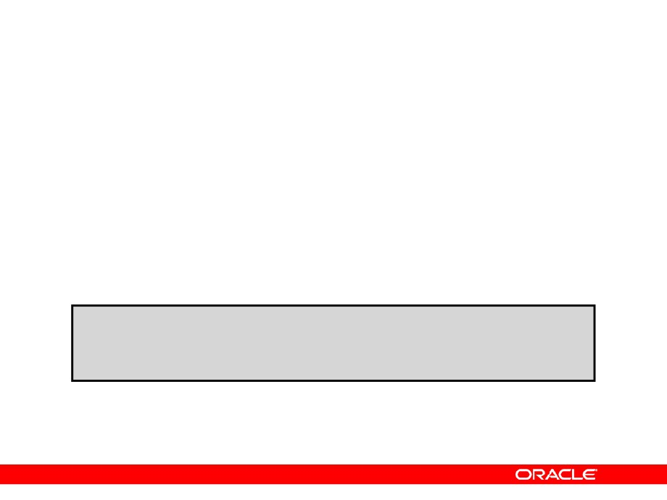
Adding a Constraint Syntax
Use the ALTER TABLE statement to:
•
Add or drop a constraint, but not modify its
structure
•
Enable or disable constraints
•
Add a NOT NULL constraint by using the MODIFY
clause
ALTER TABLE <table_name>
ADD [CONSTRAINT <constraint_name>] type (<column_name>);
Copyright © 2004, Oracle. All rights reserved.

Slide 38
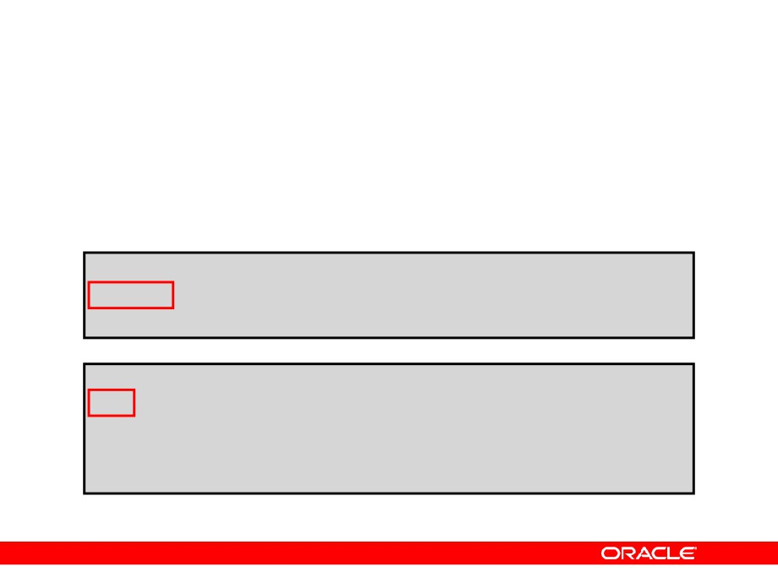
Adding a Constraint
Add a FOREIGN KEY constraint to the EMP2 table
indicating that a manager must already exist as a valid employee in the EMP2 table.
ALTER TABLE emp2
modify employee_id Primary Key;
Table altered.
ALTER TABLE emp2
ADD CONSTRAINT emp_mgr_fk
FOREIGN KEY(manager_id)
REFERENCES emp2(employee_id);
Table altered.
Copyright © 2004, Oracle. All rights reserved.

Slide 39
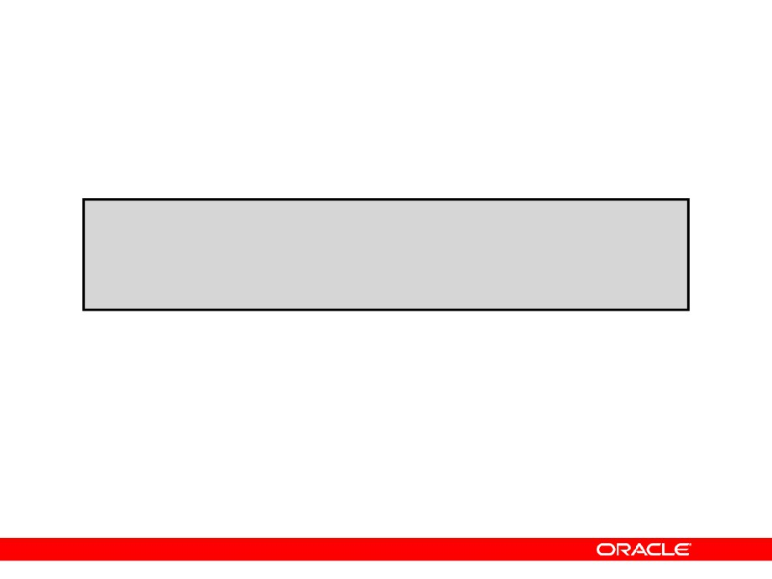
ON DELETE CASCADE
Delete child rows when a parent key is deleted.
ALTER TABLE Emp2 ADD CONSTRAINT emp_dt_fk FOREIGN KEY (Department_id)
REFERENCES departments ON DELETE CASCADE);
Table altered.
Copyright © 2004, Oracle. All rights reserved.

Slide 40
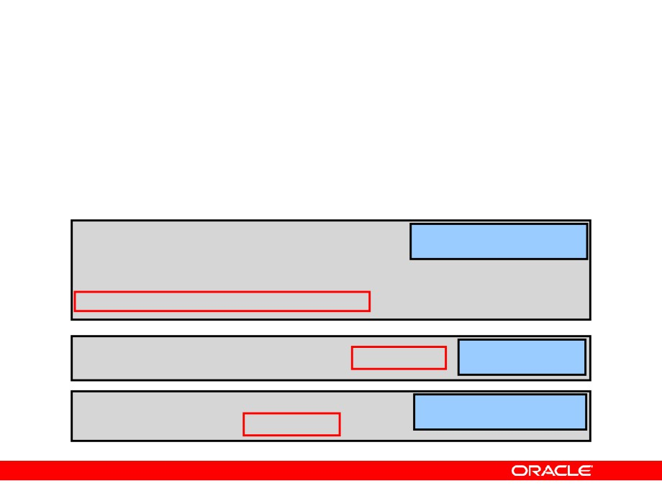
Deferring Constraints
Constraints can have the following attributes:
•
DEFERRABLE or NOT DEFERRABLE
•
INITIALLY DEFERRED or INITIALLY IMMEDIATE
ALTER TABLE dept2
Deferring constraint on creation
ADD CONSTRAINT dept2_id_pk PRIMARY KEY (department_id)
DEFERRABLE INITIALLY DEFERRED
SET CONSTRAINTS dept2_id_pk IMMEDIATE
Changing a specific constraint attribute
ALTER SESSION SET CONSTRAINTS=
Changing all constraints for a
session
IMMEDIATE
Copyright © 2004, Oracle. All rights reserved.

Slide 41
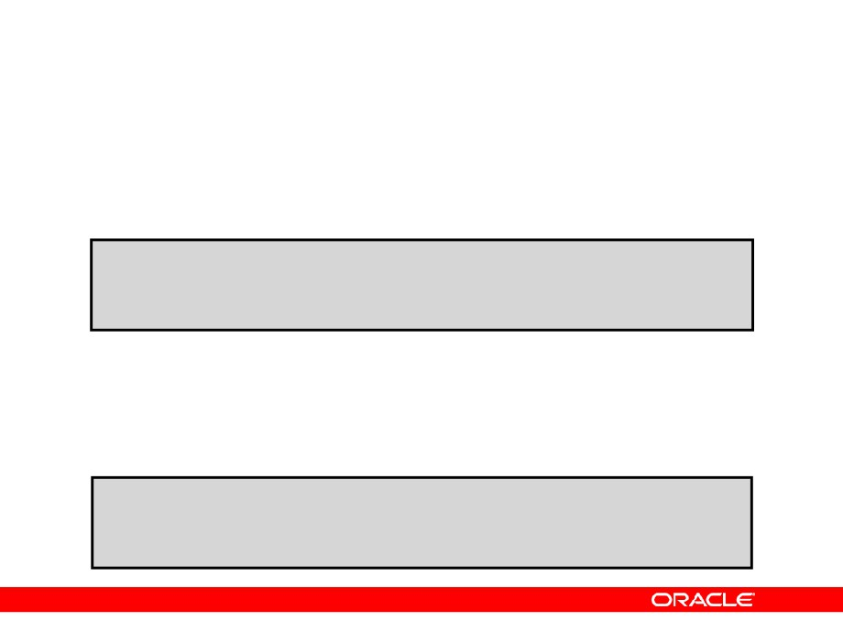
Dropping a Constraint
• Remove the manager constraint from the EMP2
table.
ALTER TABLE emp2
DROP CONSTRAINT emp_mgr_fk;
Table altered.
• Remove the PRIMARY KEY constraint on the
DEPT2 table and drop the associated FOREIGN KEY constraint on the EMP2.DEPARTMENT_ID column.
ALTER TABLE dept2
DROP PRIMARY KEY CASCADE;
Table altered.
Copyright © 2004, Oracle. All rights reserved.

Slide 42
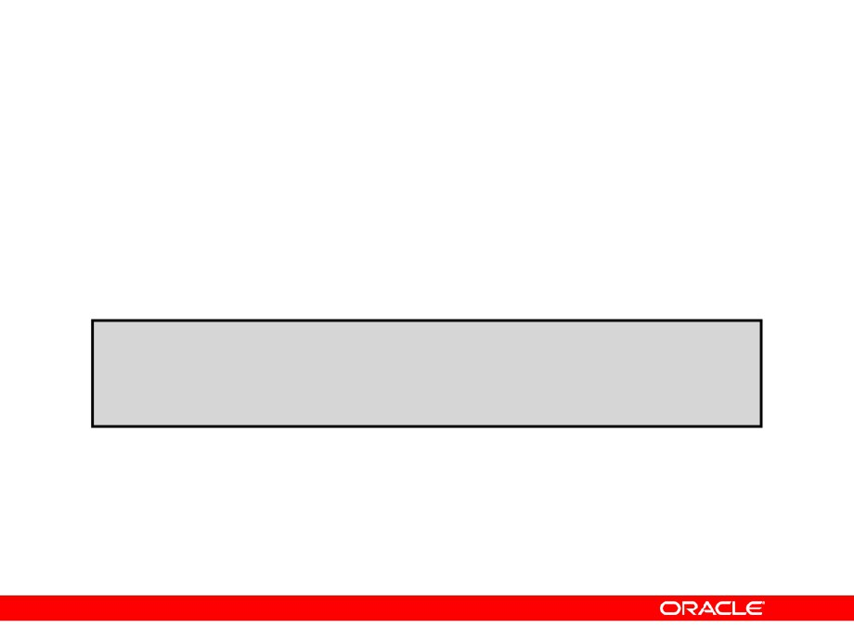
Disabling Constraints
• Execute the DISABLE clause of the ALTER TABLE
statement to deactivate an integrity constraint.
• Apply the CASCADE option to disable dependent
integrity constraints.
ALTER TABLE emp2
DISABLE CONSTRAINT emp_dt_fk;
Table altered.
Copyright © 2004, Oracle. All rights reserved.

Slide 43

Enabling Constraints
• Activate an integrity constraint currently disabled
in the table definition by using the ENABLE clause.
ALTER TABLE
emp2
ENABLE CONSTRAINT emp_dt_fk;
Table altered.
• A UNIQUE index is automatically created if you
enable a UNIQUE key or PRIMARY KEY constraint.
Copyright © 2004, Oracle. All rights reserved.

Slide 44
Cascading Constraints
• The CASCADE CONSTRAINTS clause is used along
with the DROP COLUMN clause.
• The CASCADE CONSTRAINTS clause drops all
referential integrity constraints that refer to the primary and unique keys defined on the dropped columns.
• The CASCADE CONSTRAINTS clause also drops all
multicolumn constraints defined on the dropped columns.
Copyright © 2004, Oracle. All rights reserved.

Slide 45
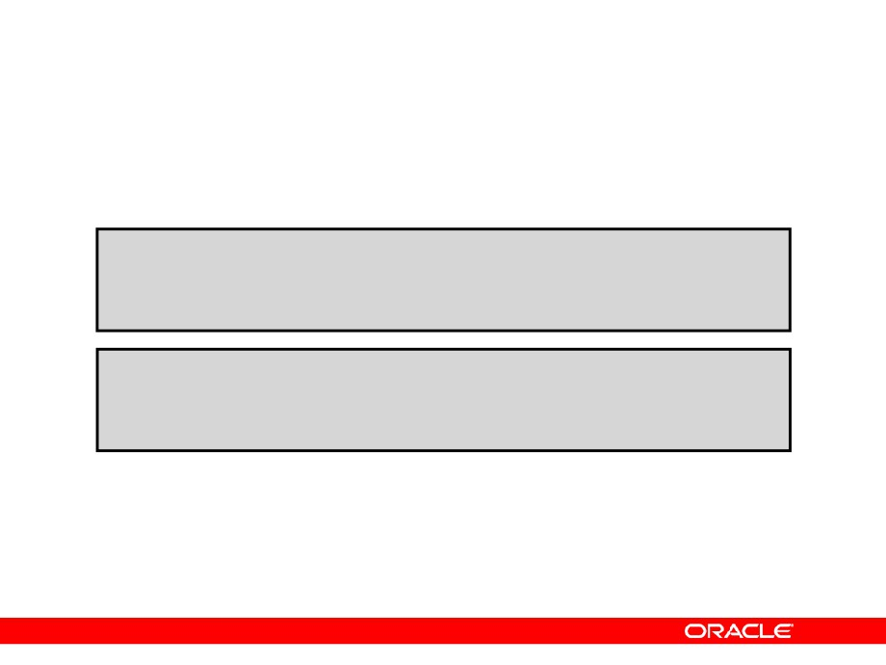
Cascading Constraints
Example:
ALTER TABLE emp2
DROP COLUMN employee_id CASCADE CONSTRAINTS;
Table altered.
ALTER TABLE test1
DROP (pk, fk, col1) CASCADE CONSTRAINTS;
Table altered.
Copyright © 2004, Oracle. All rights reserved.

Slide 46
Overview of Indexes
Indexes are created:
•
Automatically
- PRIMARY KEY creation
- UNIQUE KEY creation
•
Manually
- CREATE INDEX statement
- CREATE TABLE statement
Copyright © 2004, Oracle. All rights reserved.

Slide 47
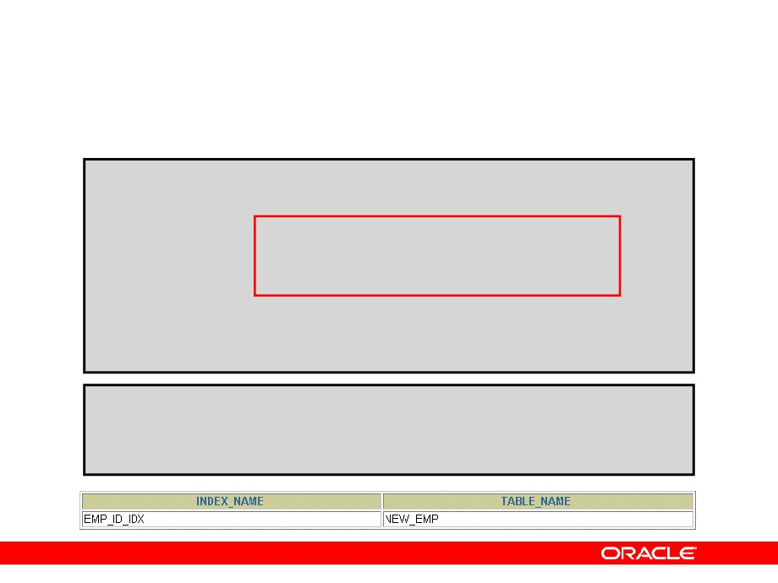
CREATE INDEX with CREATE TABLE Statement
CREATE TABLE NEW_EMP
(employee_id NUMBER(6)
PRIMARY KEY USING INDEX
(CREATE INDEX emp_id_idx ON NEW_EMP(employee_id)),
first_name VARCHAR2(20),
last_name
VARCHAR2(25));
Table created.
SELECT INDEX_NAME, TABLE_NAME
FROM
USER_INDEXES
WHERE
TABLE_NAME = 'NEW_EMP';
Copyright © 2004, Oracle. All rights reserved.

Slide 48
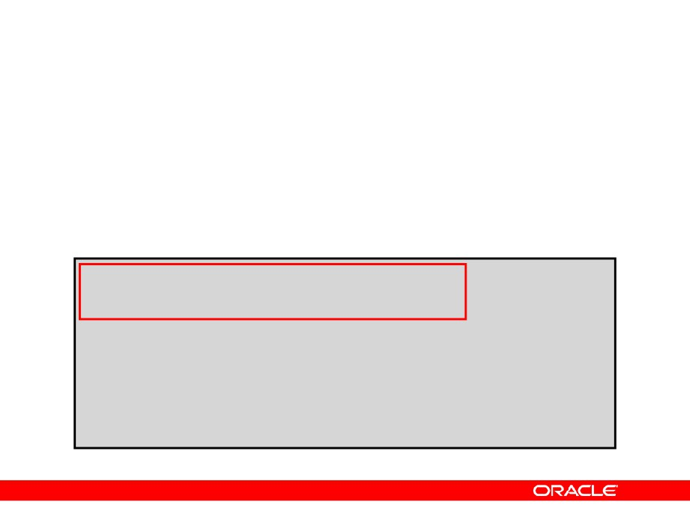
Function-Based Indexes
•
A function-based index is based on expressions.
•
The index expression is built from table columns,
constants, SQL functions, and user-defined functions.
CREATE INDEX upper_dept_name_idx ON dept2(UPPER(department_name));
Index created.
SELECT *
FROM
dept2
WHERE
UPPER(department_name) = 'SALES';
Copyright © 2004, Oracle. All rights reserved.

Slide 49
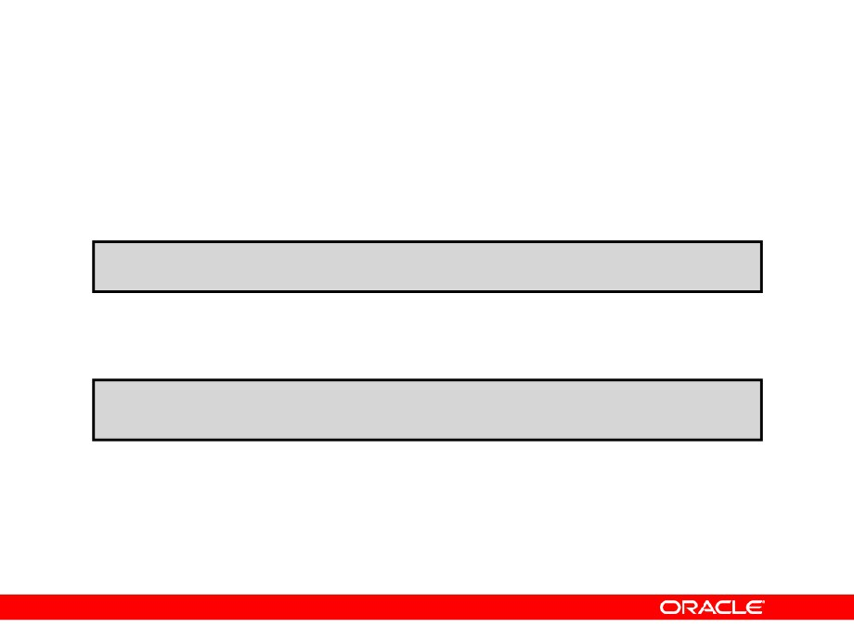
Removing an Index
• Remove an index from the data dictionary by
using the DROP INDEX command.
DROP INDEX index;
• Remove the UPPER_DEPT_NAME_IDX index from
the data dictionary.
DROP INDEX upper_dept_name_idx;
Index dropped.
• To drop an index, you must be the owner of the
index or have the DROP ANY INDEX privilege.
Copyright © 2004, Oracle. All rights reserved.

Slide 50
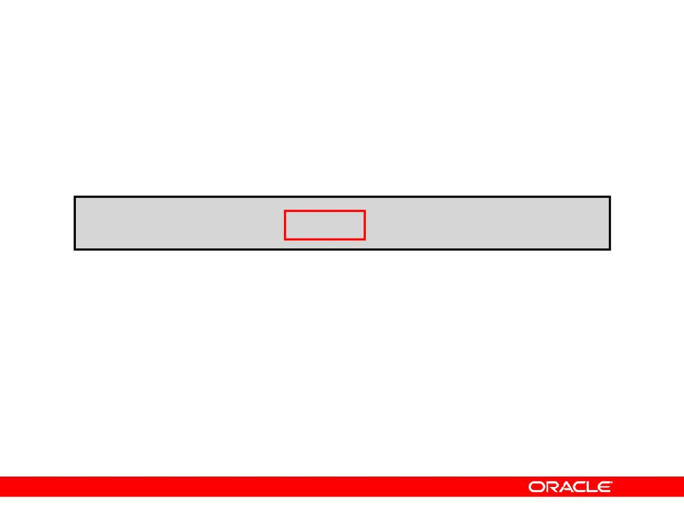
DROP TABLE … PURGE
DROP TABLE dept80 PURGE;
Copyright © 2004, Oracle. All rights reserved.

Slide 51
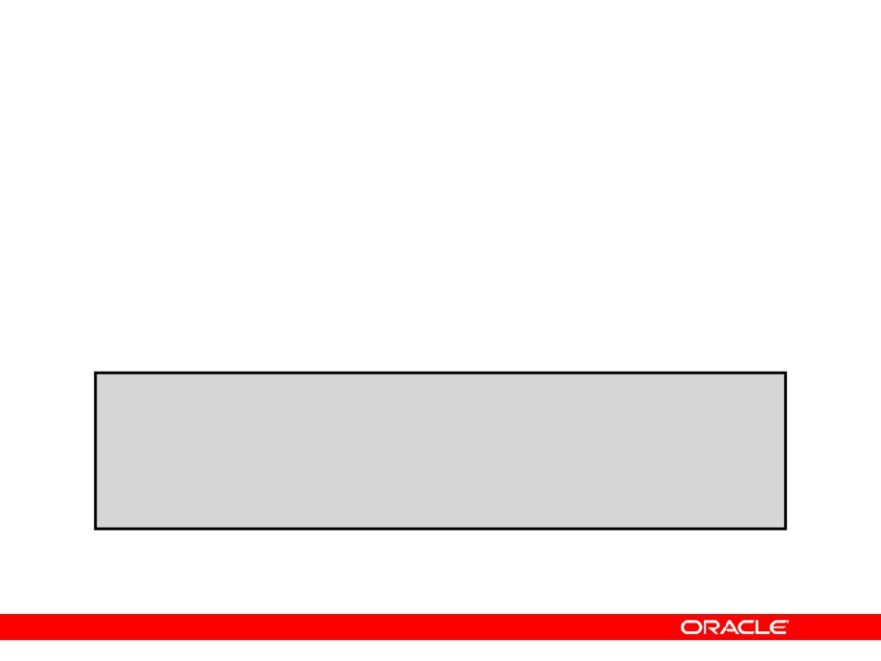
The FLASHBACK TABLE Statement
• Repair tool for accidental table modifications
- Restores a table to an earlier point in time
- Benefits: Ease of use, availability, fast execution
- Performed in place
•
Syntax:
FLASHBACK TABLE[schema.]table[, [ schema.]table ]...
TO { TIMESTAMP | SCN } expr
[ { ENABLE | DISABLE } TRIGGERS ];
Copyright © 2004, Oracle. All rights reserved.

Slide 52
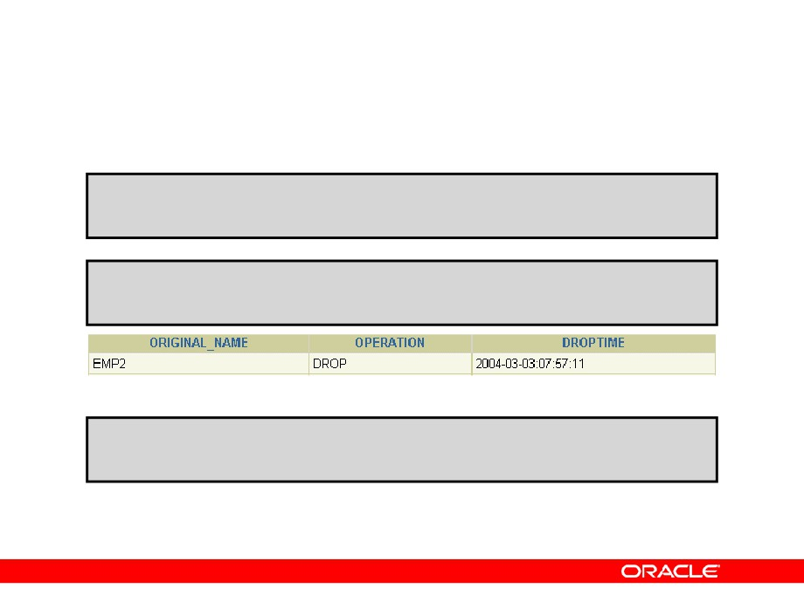
The FLASHBACK TABLE Statement
DROP TABLE emp2;
Table dropped
SELECT original_name, operation, droptime, FROM recyclebin;
…
FLASHBACK TABLE emp2 TO BEFORE DROP;
Flashback complete
Copyright © 2004, Oracle. All rights reserved.

Slide 53
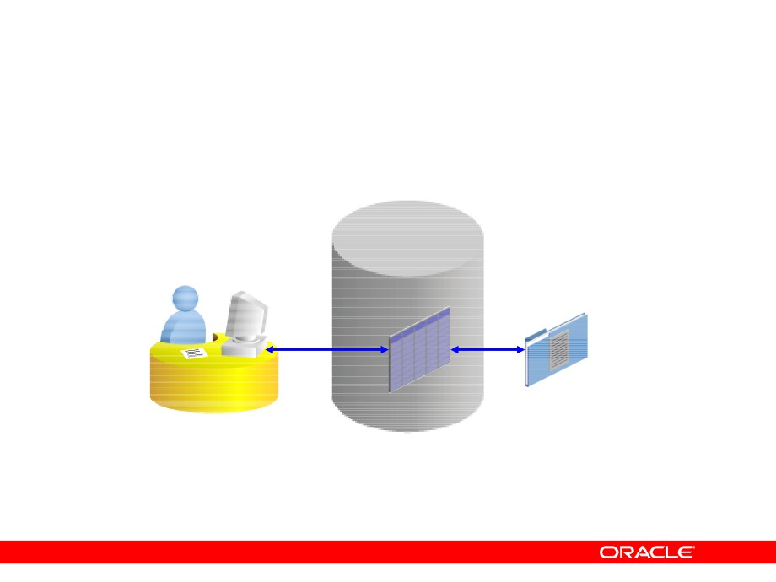
External Tables
Copyright © 2004, Oracle. All rights reserved.

Slide 54
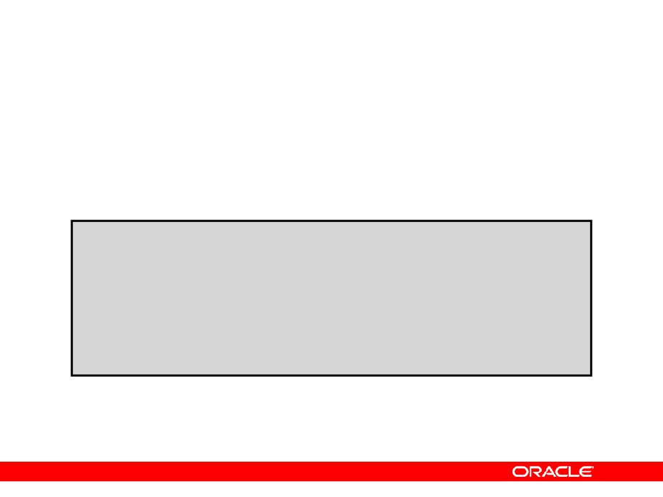
Creating a Directory for the External Table
Create a DIRECTORY object that corresponds to the directory on the file system where the external data source resides.
CREATE OR REPLACE DIRECTORY emp_dir AS '/…/emp_dir';
GRANT READ ON DIRECTORY emp_dir TO hr;
Copyright © 2004, Oracle. All rights reserved.

Slide 55

Creating an External Table
CREATE TABLE <table_name>
( <col_name> <datatype>, … ) ORGANIZATION EXTERNAL
(TYPE <access_driver_type>
DEFAULT DIRECTORY <directory_name> ACCESS PARAMETERS
(… ) )
LOCATION ('<location_specifier>') ) REJECT LIMIT [0 | <number> | UNLIMITED];
Copyright © 2004, Oracle. All rights reserved.

Slide 56

Creating an External Table Using
ORACLE_LOADER
CREATE TABLE oldemp (
fname char(25), lname CHAR(25)) ORGANIZATION EXTERNAL
(TYPE ORACLE_LOADER
DEFAULT DIRECTORY emp_dir ACCESS PARAMETERS
(RECORDS DELIMITED BY NEWLINE NOBADFILE
NOLOGFILE
FIELDS TERMINATED BY ','
(fname POSITION ( 1:20) CHAR, lname POSITION (22:41) CHAR)) LOCATION ('emp.dat'))
PARALLEL 5
REJECT LIMIT 200;
Table created.
Copyright © 2004, Oracle. All rights reserved.

Slide 57
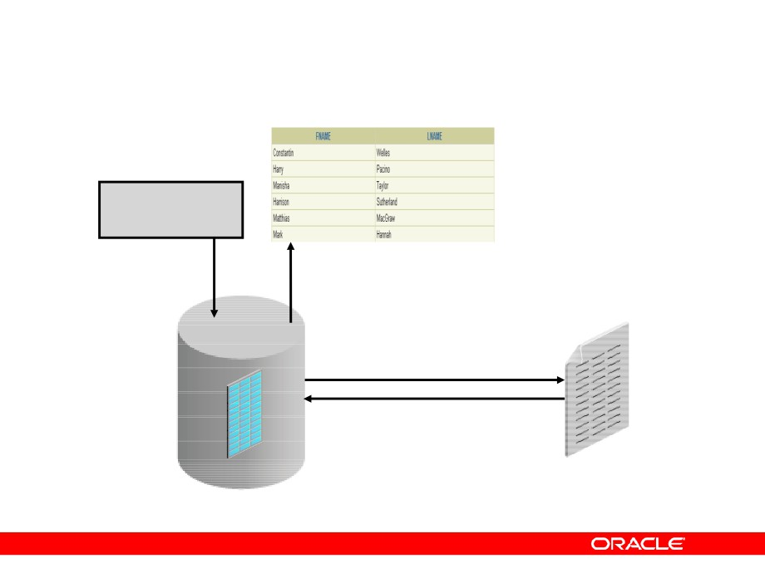
Querying External Tables
SELECT *
FROM oldemp
OLDEMP
emp.dat
Copyright © 2004, Oracle. All rights reserved.

Slide 58
Summary
In this lesson, you should have learned how to:
•
Add constraints
•
Create indexes
•
Create a primary key constraint using an index
•
Create indexes using the CREATE TABLE
statement
•
Creating function-based indexes
•
Drop columns and set column UNUSED
•
Perform FLASHBACK operations
•
Create and use external tables
Copyright © 2004, Oracle. All rights reserved.

Slide 59
Practice 2: Overview
This practice covers the following topics:
•
Altering tables
•
Adding columns
•
Dropping columns
•
Creating indexes
•
Creating external tables
Copyright © 2004, Oracle. All rights reserved.

Slide 60

Manipulating Large Data Sets
Copyright © 2004, Oracle. All rights reserved.

Slide 61
Objectives
After completing this lesson, you should be able to do the following:
•
Manipulate data using subqueries
•
Describe the features of multitable inserts
•
Use the following types of multitable inserts
- Unconditional INSERT
- Pivoting INSERT
- Conditional ALL INSERT
- Conditional FIRST INSERT
•
Merge rows in a table
•
Track the changes to data over a period of time
Copyright © 2004, Oracle. All rights reserved.

Slide 62
Using Subqueries to Manipulate Data
You can use subqueries in DML statements to:
•
Copy data from one table to another
•
Retrieve data from an inline view
•
Update data in one table based on the values of
another table
• Delete rows from one table based on rows in a
another table
Copyright © 2004, Oracle. All rights reserved.

Slide 63
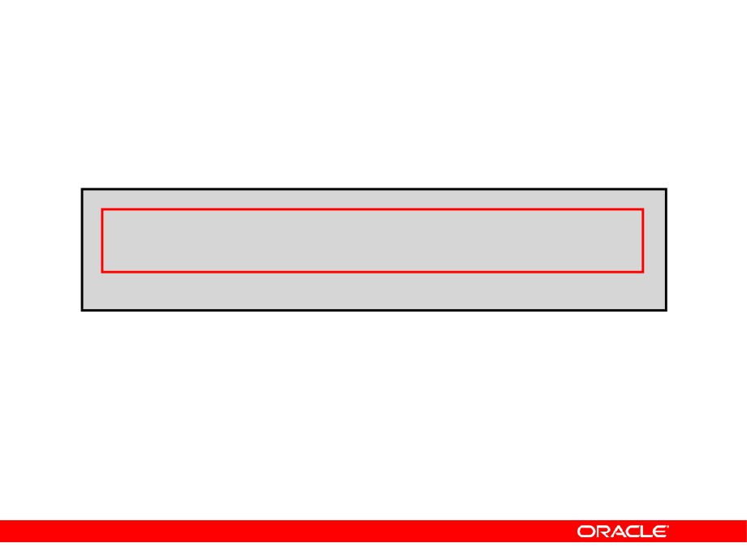
Copying Rows from Another Table
•
Write your INSERT statement with a subquery.
INSERT INTO sales_reps(id, name, salary, commission_pct)
SELECT employee_id, last_name, salary, commission_pct
FROM
employees
WHERE
job_id LIKE '%REP%';
33 rows created.
•
Do not use the VALUES clause.
•
Match the number of columns in the INSERT
clause with that in the subquery.
Copyright © 2004, Oracle. All rights reserved.

Slide 64

Inserting Using a Subquery as a Target
INSERT INTO
(SELECT employee_id, last_name,
email, hire_date, job_id, salary, department_id
FROM
empl3
WHERE
department_id = 50)
VALUES (99999, 'Taylor', 'DTAYLOR',
TO_DATE('07-JUN-99', 'DD-MON-RR'), 'ST_CLERK', 5000, 50);
1 row created.
Copyright © 2004, Oracle. All rights reserved.

Slide 65
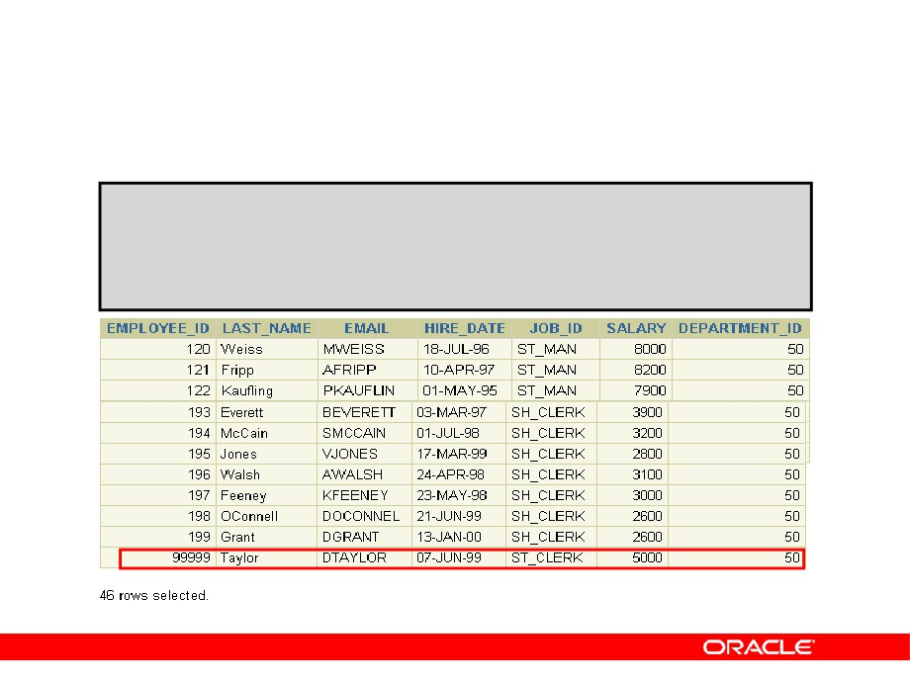
Inserting Using a Subquery as a Target
Verify the results.
SELECT employee_id, last_name, email, hire_date, job_id, salary, department_id
FROM
employees
WHERE
department_id = 50;
…
Copyright © 2004, Oracle. All rights reserved.

Slide 66
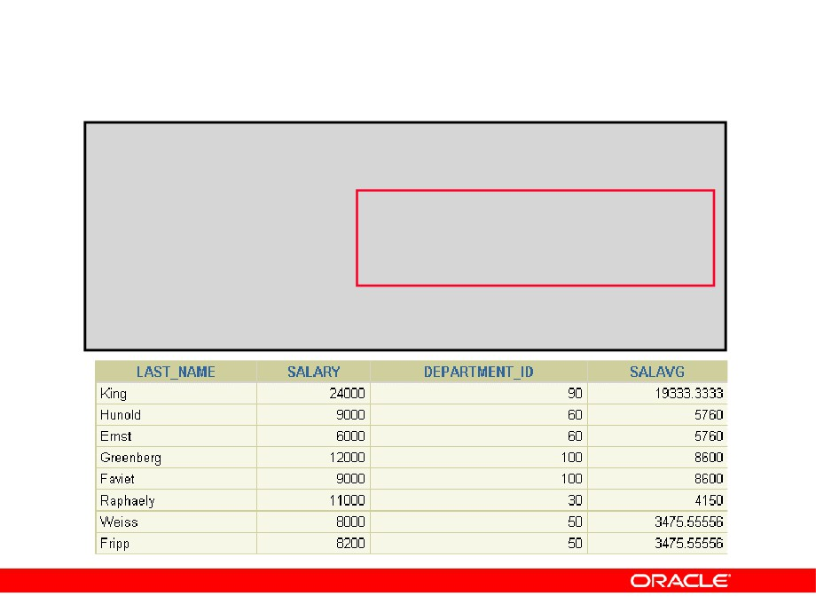
Retrieving Data with a Subquery as Source
SELECT a.last_name, a.salary,
a.department_id, b.salavg
FROM
employees a,
(SELECT
department_id,
AVG(salary) salavg
FROM
employees
GROUP BY department_id) b
WHERE
a.department_id = b.department_id
AND
a.salary > b.salavg;
…
Copyright © 2004, Oracle. All rights reserved.

Slide 67
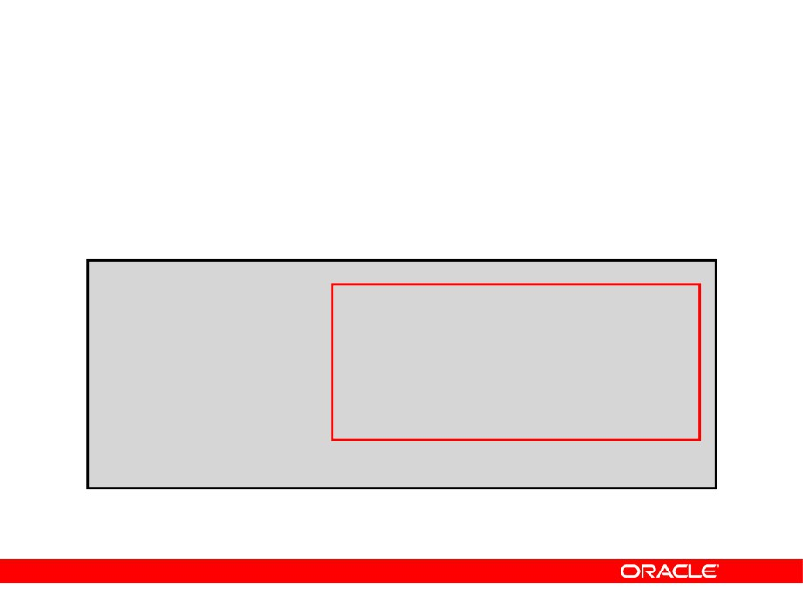
Updating Two Columns with a Subquery
Update the job and salary of employee 114 to match the job of employee 205 and the salary of employee 168.
UPDATE
empl3
SET
job_id
=
(SELECT job_id
FROM
employees
WHERE
employee_id = 205),
salary
=
(SELECT salary
FROM
employees
WHERE
employee_id = 168)
WHERE
employee_id
=
114;
1 row updated.
Copyright © 2004, Oracle. All rights reserved.

Slide 68
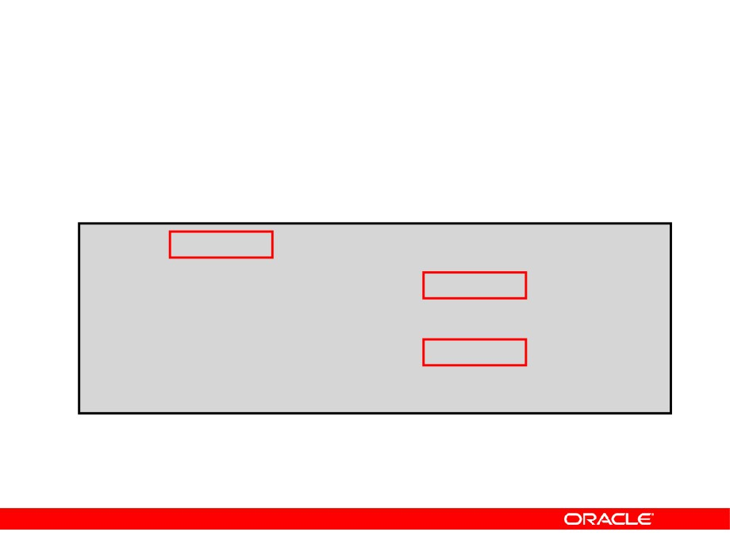
Updating Rows Based on Another Table
Use subqueries in UPDATE statements to update rows in a table based on values from another table.
UPDATE empl3
SET department_id
= (SELECT department_id FROMemployees
WHERE employee_id = 100) = (SELECT job_id
WHERE job_id
FROM employees WHERE employee_id = 200);
1 row updated.
Copyright © 2004, Oracle. All rights reserved.

Slide 69
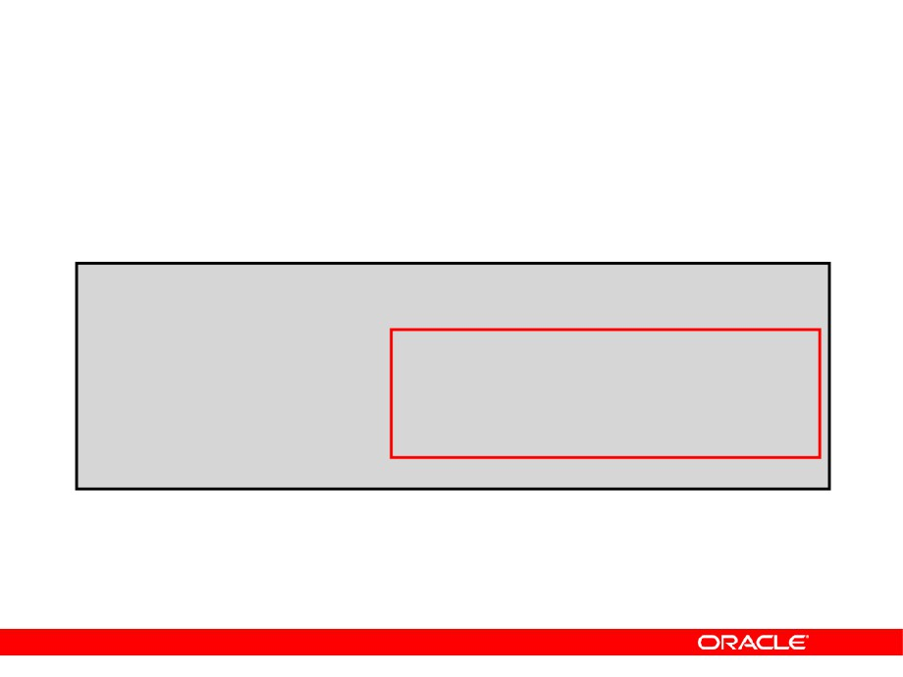
Deleting Rows Based on Another Table
Use subqueries in DELETE statements to remove rows from a table based on values from another table.
DELETE FROM empl3
WHERE department_id =
(SELECT department_id
FROM
departments
WHERE
department_name
LIKE '%Public%');
1 row deleted.
Copyright © 2004, Oracle. All rights reserved.

Slide 70
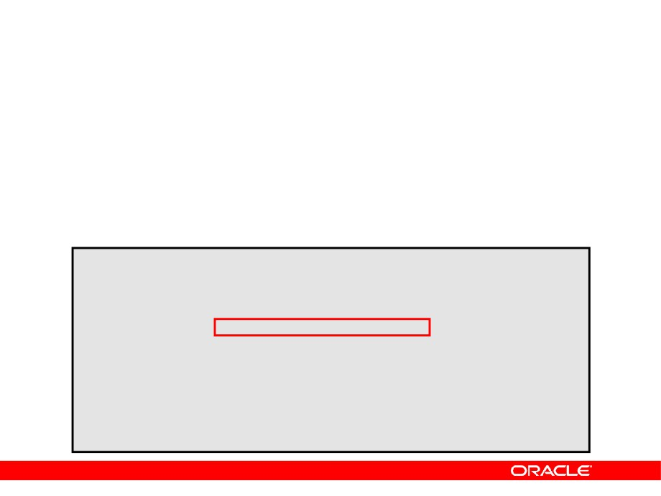
Using the WITH CHECK OPTION Keyword on DML Statements
• A subquery is used to identify the table and
columns of the DML statement.
• The WITH CHECK OPTION keyword prohibits you
from changing rows that are not in the subquery.
INSERT INTO (SELECT employee_id, last_name, email,
hire_date, job_id, salary
FROM
empl3
WHERE
department_id = 50
WITH CHECK OPTION)
VALUES (99998, 'Smith', 'JSMITH',
TO_DATE('07-JUN-99', 'DD-MON-RR'), 'ST_CLERK', 5000);
INSERT INTO
*
ERROR at line 1:
ORA-01402: view WITH CHECK OPTION where-clause violation
Copyright © 2004, Oracle. All rights reserved.

Slide 71
Overview of the Explicit Default Feature
• With the explicit default feature, you can use the
DEFAULT keyword as a column value where the column default is desired.
• The addition of this feature is for compliance with
the SQL:1999 standard.
• This allows the user to control where and when
the default value should be applied to data.
• Explicit defaults can be used in INSERT and
UPDATE statements.
Copyright © 2004, Oracle. All rights reserved.

Slide 72
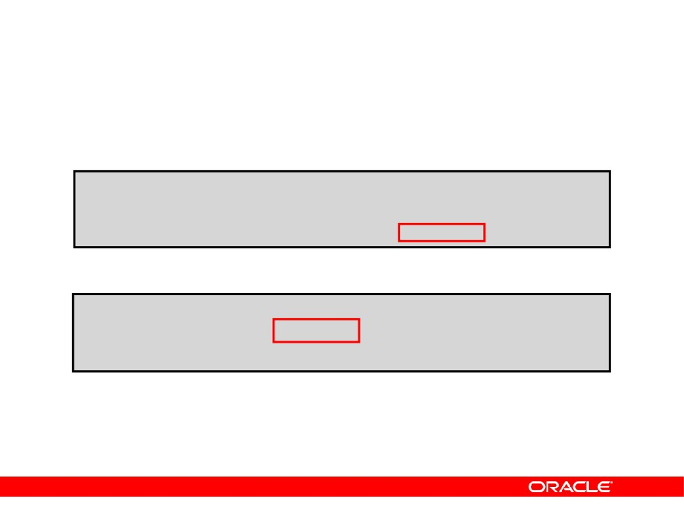
Using Explicit Default Values
•
DEFAULT with INSERT:
INSERT INTO deptm3
(department_id, department_name, manager_id) VALUES (300, 'Engineering',DEFAULT);
•
DEFAULT with UPDATE:
UPDATE deptm3
SET manager_id = DEFAULT WHERE department_id = 10;
Copyright © 2004, Oracle. All rights reserved.

Slide 73
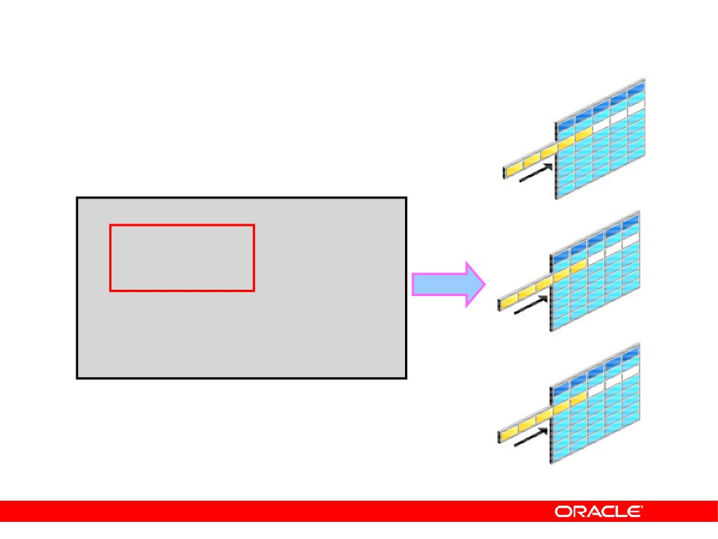
Overview of Multitable INSERT Statements
INSERT ALL INTO table_a
Table_a
VALUES(…,…,…) VALUES(…,…,…) VALUES(…,…,…)
INTO table_b INTO table_c SELECT …
FROM sourcetab
WHERE …;
Table_b
Table_c
Copyright © 2004, Oracle. All rights reserved.

Slide 74
Overview of Multitable INSERT Statements
• The INSERT…SELECT statement can be used to
insert rows into multiple tables as part of a single DML statement.
• Multitable INSERT statements can be used in data
warehousing systems to transfer data from one or more operational sources to a set of target tables.
• They provide significant performance
improvement over:
- Single DML versus multiple INSERT…SELECT statements
- Single DML versus a procedure to do multiple inserts using IF...THEN syntax
Copyright © 2004, Oracle. All rights reserved.

Slide 75
Types of Multitable INSERT Statements
The different types of multitable INSERT statements are:
•
Unconditional INSERT
•
Conditional ALL INSERT
•
Conditional FIRST INSERT
•
Pivoting INSERT
Copyright © 2004, Oracle. All rights reserved.

Slide 76
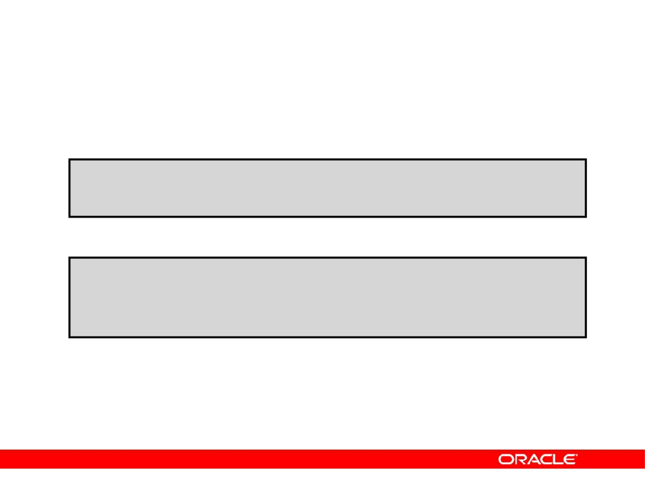
Multitable INSERT Statements
•
Syntax
INSERT [ALL] [conditional_insert_clause]
[insert_into_clause values_clause] (subquery)
• conditional_insert_clause
[ALL] [FIRST]
[WHEN condition THEN] [insert_into_clause values_clause] [ELSE] [insert_into_clause values_clause]
Copyright © 2004, Oracle. All rights reserved.

Slide 77
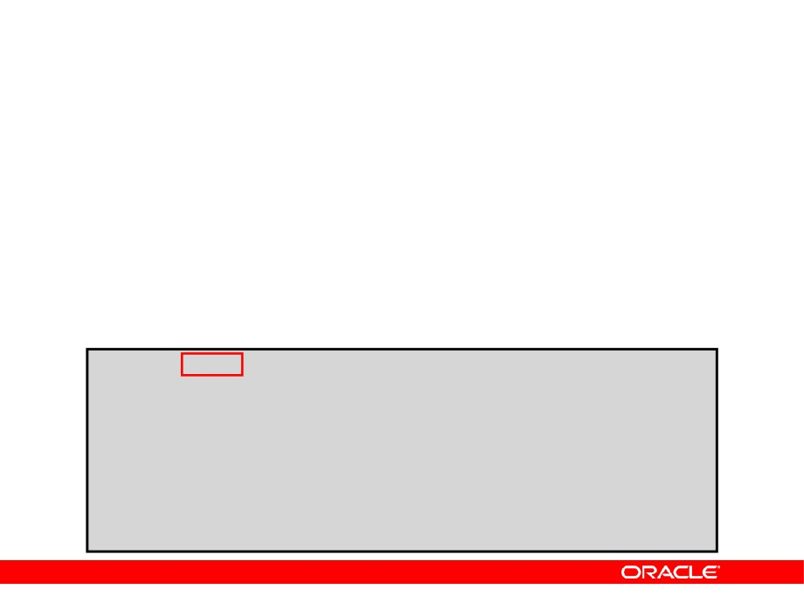
Unconditional INSERT ALL
• Select the EMPLOYEE_ID, HIRE_DATE, SALARY, and
MANAGER_ID values from the EMPLOYEES table for those employees whose EMPLOYEE_ID is greater than 200.
• Insert these values into the SAL_HISTORY and
MGR_HISTORY tables using a multitable INSERT.
INSERT
ALL
INTO sal_history VALUES(EMPID,HIREDATE,SAL) INTO mgr_history VALUES(EMPID,MGR,SAL) SELECT employee_id EMPID, hire_date HIREDATE, salary SAL, manager_id MGR
FROM employees
WHERE employee_id > 200;
12 rows created.
Copyright © 2004, Oracle. All rights reserved.

Slide 78
Conditional INSERT ALL
• Select the EMPLOYEE_ID, HIRE_DATE, SALARY, and
MANAGER_ID values from the EMPLOYEES table for those employees whose EMPLOYEE_ID is greater than 200.
• If the SALARY is greater than $10,000, insert these
values into the SAL_HISTORY table using a conditional multitable INSERT statement.
• If the MANAGER_ID is greater than 200, insert these
values into the MGR_HISTORY table using a conditional multitable INSERT statement.
Copyright © 2004, Oracle. All rights reserved.

Slide 79
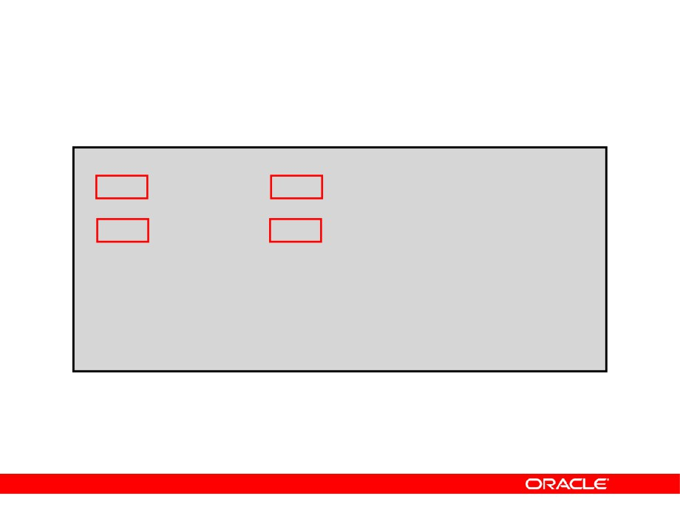
Conditional INSERT ALL
INSERT ALL
WHEN
SAL > 10000
THEN
INTO sal_history VALUES(EMPID,HIREDATE,SAL)
WHEN
MGR > 200
THEN
INTO mgr_history VALUES(EMPID,MGR,SAL)
SELECT employee_id EMPID,hire_date HIREDATE,
salary SAL, manager_id MGR
FROM
employees
WHERE
employee_id > 200;
4 rows created.
Copyright © 2004, Oracle. All rights reserved.

Slide 80
Conditional INSERT FIRST
• Select the DEPARTMENT_ID, SUM(SALARY), and
MAX(HIRE_DATE) from the EMPLOYEES table.
• If the SUM(SALARY) is greater than $25,000, then
insert these values into the SPECIAL_SAL, using a conditional FIRST multitable INSERT.
• If the first WHEN clause evaluates to true, then the
subsequent WHEN clauses for this row should be skipped.
• For the rows that do not satisfy the first WHEN
condition, insert into the HIREDATE_HISTORY_00, HIREDATE_HISTORY_99, or HIREDATE_HISTORY tables, based on the value in the HIRE_DATE column using a conditional multitable INSERT.
Copyright © 2004, Oracle. All rights reserved.

Slide 81
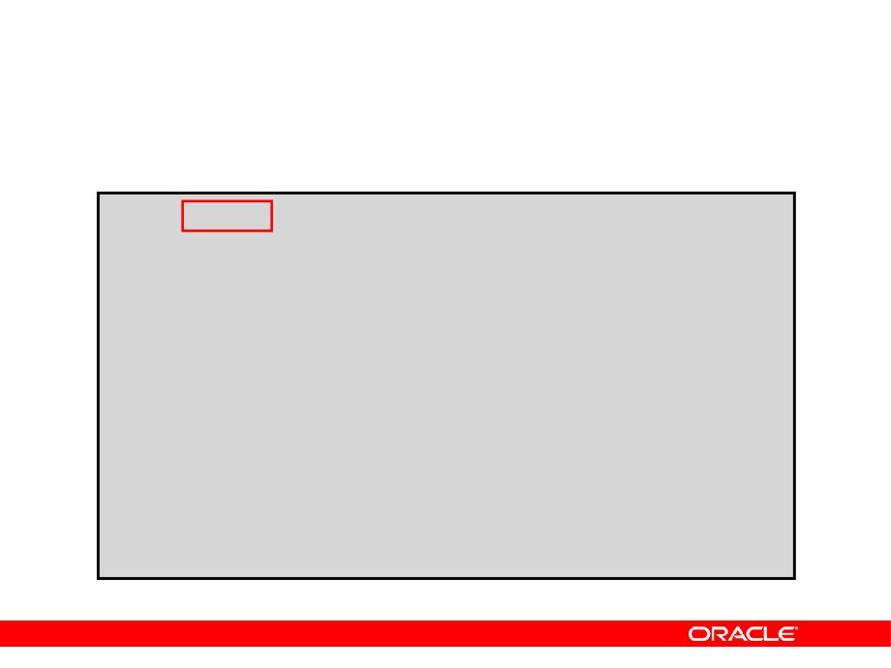
Conditional INSERT FIRST
INSERT
FIRST
WHEN SAL
> 25000
THEN
INTO special_sal VALUES(DEPTID, SAL) WHEN HIREDATE like ('%00%') THEN
INTO hiredate_history_00 VALUES(DEPTID,HIREDATE) WHEN HIREDATE like ('%99%') THEN
INTO hiredate_history_99 VALUES(DEPTID, HIREDATE) ELSE
INTO hiredate_history VALUES(DEPTID, HIREDATE) SELECT department_id DEPTID, SUM(salary) SAL, MAX(hire_date) HIREDATE
FROM
employees
GROUP BY department_id;
12 rows created.
Copyright © 2004, Oracle. All rights reserved.

Slide 82
Pivoting INSERT
• Suppose you receive a set of sales records from a
nonrelational database table,
SALES_SOURCE_DATA, in the following format:
EMPLOYEE_ID, WEEK_ID, SALES_MON, SALES_TUE, SALES_WED, SALES_THUR, SALES_FRI
• You want to store these records in the
SALES_INFO table in a more typical relational format:
EMPLOYEE_ID, WEEK, SALES
• Using a pivoting INSERT, convert the set of sales
records from the nonrelational database table to relational format.
Copyright © 2004, Oracle. All rights reserved.

Slide 83

Pivoting INSERT
INSERT ALL
INTO
sales_info
VALUES (employee_id,week_id,sales_MON)
INTO
sales_info
VALUES (employee_id,week_id,sales_TUE)
INTO
sales_info
VALUES (employee_id,week_id,sales_WED)
INTO
sales_info
VALUES (employee_id,week_id,sales_THUR)
INTO
sales_info
VALUES (employee_id,week_id, sales_FRI)
SELECT EMPLOYEE_ID, week_id, sales_MON, sales_TUE, sales_WED, sales_THUR,sales_FRI
FROM sales_source_data;
5 rows created.
Copyright © 2004, Oracle. All rights reserved.

Slide 84
The MERGE Statement
• Provides the ability to conditionally update or
insert data into a database table
• Performs an UPDATE if the row exists, and an
INSERT if it is a new row:
- Avoids separate updates
- Increases performance and ease of use
- Is useful in data warehousing applications
Copyright © 2004, Oracle. All rights reserved.

Slide 85

The MERGE Statement Syntax
You can conditionally insert or update rows in a table by using the MERGE statement.
MERGE INTO table_name table_alias
USING (table|view|sub_query) alias ON (join condition)
WHEN MATCHED THEN UPDATE SET
col1 = col_val1, col2 = col2_val
WHEN NOT MATCHED THEN
INSERT (column_list)
VALUES (column_values);
Copyright © 2004, Oracle. All rights reserved.

Slide 86

Merging Rows
Insert or update rows in the EMPL3 table to match the EMPLOYEES table.
MERGE INTO empl3 c USING employees e
ON (c.employee_id = e.employee_id) WHEN MATCHED THEN
UPDATE SET
c.first_name
= e.first_name,
c.last_name
= e.last_name,
c.department_id = e.department_id WHEN NOT MATCHED THEN
INSERT VALUES(e.employee_id, e.first_name, e.last_name, e.email, e.phone_number, e.hire_date, e.job_id, e.salary, e.commission_pct, e.manager_id, e.department_id);
Copyright © 2004, Oracle. All rights reserved.

Slide 87

Merging Rows
TRUNCATE TABLE empl3;
SELECT *
FROM empl3;
no rows selected
MERGE INTO empl3 c USING employees e
ON (c.employee_id = e.employee_id) WHEN MATCHED THEN
UPDATE SET
WHEN NOT MATCHED THEN INSERT VALUES...;
SELECT *
FROM empl3;
107 rows selected.
Copyright © 2004, Oracle. All rights reserved.

Slide 88

Tracking Changes in Data
SELECT
…
Versions of retrieved rows
Copyright © 2004, Oracle. All rights reserved.

Slide 89

Example of the Flashback Version Query
SELECT salary FROM employees3 WHERE employee_id = 107;
1
UPDATE employees3 SET salary = salary * 1.30
WHERE employee_id = 107; COMMIT;
2
SELECT salary FROM employees3
VERSIONS BETWEEN SCN MINVALUE AND MAXVALUE WHERE employee_id = 107;
3
Copyright © 2004, Oracle. All rights reserved.

Slide 90

The VERSIONS BETWEEN Clause
SELECT versions_starttime "START_DATE",
versions_endtime
"END_DATE",
salary
FROM
employees
VERSIONS BETWEEN SCN MINVALUE AND MAXVALUE
WHERE last_name = 'Lorentz';
Copyright © 2004, Oracle. All rights reserved.

Slide 91
Summary
In this lesson, you should have learned how to:
•
Use DML statements and control transactions
•
Describe the features of multitable inserts
•
Use the following types of multitable inserts
- Unconditional INSERT
- Pivoting INSERT
- Conditional ALL INSERT
- Conditional FIRST INSERT
•
Merge rows in a table
•
Manipulate data using subqueries
•
Track the changes to data over a period of time
Copyright © 2004, Oracle. All rights reserved.

Slide 92
Practice 3: Overview
This practice covers the following topics:
•
Performing multitable INSERTs
•
Performing MERGE operations
•
Tracking row versions
Copyright © 2004, Oracle. All rights reserved.

Slide 93

Generating Reports by Grouping Related Data
Copyright © 2004, Oracle. All rights reserved.

Slide 94
Objectives
After completing this lesson, you should be able to do the following:
• Use the ROLLUP operation to produce
subtotal values
• Use the CUBE operation to produce cross-
tabulation values
• Use the GROUPING function to identify the row
values created by ROLLUP or CUBE
• Use GROUPING SETS to produce a single result set
Copyright © 2004, Oracle. All rights reserved.

Slide 95

Review of Group Functions
• Group functions operate on sets of rows to give
one result per group.
SELECT
[column,]
group_function(column). . .
FROM
table
[WHERE
condition]
[GROUP BY
group_by_expression]
[ORDER BY
column];
•
Example:
SELECT AVG(salary), STDDEV(salary),
COUNT(commission_pct),MAX(hire_date)
FROM
employees
WHERE
job_id LIKE 'SA%';
Copyright © 2004, Oracle. All rights reserved.

Slide 96

Review of the GROUP BY Clause
•
Syntax:
SELECT
[column,]
group_function(column). . .
FROM
table
[WHERE
condition]
[GROUP BY
group_by_expression]
[ORDER BY
column];
•
Example:
SELECT
department_id, job_id, SUM(salary),
COUNT(employee_id)
FROM
employees
GROUP BY department_id, job_id
;
Copyright © 2004, Oracle. All rights reserved.

Slide 97

Review of the HAVING Clause
• Use the HAVING clause to specify which groups
are to be displayed.
•
You further restrict the groups on the basis of a
limiting condition.
SELECT
[column,] group_function(column)...
FROM
table
[WHERE
condition]
[GROUP BY
group_by_expression]
[HAVING
having_expression]
[ORDER BY
column];
Copyright © 2004, Oracle. All rights reserved.

Slide 98
GROUP BY with ROLLUP and CUBE Operators
• Use ROLLUP or CUBE with GROUP BY to produce
superaggregate rows by cross-referencing columns.
• ROLLUP grouping produces a result set containing
the regular grouped rows and the subtotal values.
• CUBE grouping produces a result set containing
the rows from ROLLUP and cross-tabulation rows.
Copyright © 2004, Oracle. All rights reserved.

Slide 99

ROLLUP Operator
•
ROLLUP is an extension to the GROUP BY clause.
•
Use the ROLLUP operation to produce cumulative
aggregates, such as subtotals.
SELECT
[column,] group_function(column). . .
FROM
table
[WHERE
condition]
[GROUP BY
[ROLLUP]
group_by_expression]
[HAVING
having_expression];
[ORDER BY
column];
Copyright © 2004, Oracle. All rights reserved.

Slide 100

ROLLUP Operator: Example
SELECT
department_id, job_id, SUM(salary)
FROM
employees
WHERE
department_id < 60
GROUP BY ROLLUP(department_id, job_id);
1
2
3
Copyright © 2004, Oracle. All rights reserved.

Slide 101

CUBE Operator
•
CUBE is an extension to the GROUP BY clause.
•
You can use the CUBE operator to produce cross-
tabulation values with a single SELECT statement.
SELECT
[column,] group_function(column)...
FROM
table
[WHERE
condition]
[GROUP BY
[CUBE]
group_by_expression]
[HAVING
having_expression]
[ORDER BY
column];
Copyright © 2004, Oracle. All rights reserved.

Slide 102

CUBE Operator: Example
SELECT
department_id, job_id, SUM(salary)
FROM
employees
WHERE
department_id < 60
GROUP BY CUBE (department_id, job_id)
;
1
2
3
4
Copyright © 2004, Oracle. All rights reserved.

Slide 103

GROUPING Function
The GROUPING function:
•
Is used with either the CUBE or ROLLUP operator
•
Is used to find the groups forming the subtotal in
a row
•
Is used to differentiate stored NULL values from
NULL values created by ROLLUP or CUBE
•
Returns 0 or 1
SELECT
[column,] group_function(column) .. ,
GROUPING(expr)
FROM
table
[WHERE
condition]
[GROUP BY [ROLLUP][CUBE] group_by_expression] [HAVING having_expression]
[ORDER BY column];
Copyright © 2004, Oracle. All rights reserved.

Slide 104

GROUPING Function: Example
SELECT department_id DEPTID, job_id JOB,
SUM(salary),
GROUPING(department_id) GRP_DEPT, GROUPING(job_id) GRP_JOB
FROM
employees
WHERE
department_id < 50
GROUP BY ROLLUP(department_id, job_id);
1
2
3
Copyright © 2004, Oracle. All rights reserved.

Slide 105
GROUPING SETS
• GROUPING SETS syntax is used to define multiple
groupings in the same query.
• All groupings specified in the GROUPING SETS
clause are computed and the results of individual groupings are combined with a UNION ALL operation.
•
Grouping set efficiency:
- Only one pass over the base table is required.
- There is no need to write complex UNION statements.
- The more elements GROUPING SETS has, the greater the performance benefit.
Copyright © 2004, Oracle. All rights reserved.

Slide 106

GROUPING SETS: Example
SELECT department_id, job_id,
manager_id,avg(salary)
FROM
employees
GROUP BY
GROUPING SETS
((department_id,job_id), (job_id,manager_id));
1
…
2
…
Copyright © 2004, Oracle. All rights reserved.

Slide 107

Composite Columns
• A composite column is a collection of columns
that are treated as a unit.
ROLLUP (a,
(b,c)
, d)
•
Use parentheses within the GROUP BY clause to
group columns, so that they are treated as a unit while computing ROLLUP or CUBE operations.
• When used with ROLLUP or CUBE, composite
columns would require skipping aggregation across certain levels.
Copyright © 2004, Oracle. All rights reserved.

Slide 108

Composite Columns: Example
SELECT department_id, job_id, manager_id,
SUM(salary)
FROM
employees
GROUP BY ROLLUP( department_id,(job_id, manager_id));
1
2
…
3
4
Copyright © 2004, Oracle. All rights reserved.

Slide 109

Concatenated Groupings
• Concatenated groupings offer a concise way to
generate useful combinations of groupings.
• To specify concatenated grouping sets, you
separate multiple grouping sets, ROLLUP, and
CUBE operations with commas so that the Oracle server combines them into a single GROUP BY clause.
• The result is a cross-product of groupings from
each grouping set.
GROUP BY GROUPING SETS(a, b), GROUPING SETS(c, d)
Copyright © 2004, Oracle. All rights reserved.

Slide 110

Concatenated Groupings: Example
SELECT department_id, job_id, manager_id,
SUM(salary)
FROM
employees
GROUP BY department_id, ROLLUP(job_id),
CUBE(manager_id);
1
…
2
…
3
…
4
5
Copyright © 2004, Oracle. All rights reserved.

Slide 111
Summary
In this lesson, you should have learned how to use the:
•
ROLLUP operation to produce subtotal values
•
CUBE operation to produce cross-tabulation values
•
GROUPING function to identify the row values
created by ROLLUP or CUBE
• GROUPING SETS syntax to define multiple
groupings in the same query
• GROUP BY clause to combine expressions in
various ways:
- Composite columns
- Concatenated grouping sets
Copyright © 2004, Oracle. All rights reserved.

Slide 112
Practice 4: Overview
This practice covers using:
•
ROLLUP operators
•
CUBE operators
•
GROUPING functions
•
GROUPING SETS
Copyright © 2004, Oracle. All rights reserved.

Slide 113

Managing Data in Different Time Zones
Copyright © 2004, Oracle. All rights reserved.

Slide 114
Objectives
After completing this lesson, you should be able to use the following datetime functions:
• TZ_OFFSET
• CURRENT_DATE
• FROM_TZ
• CURRENT_TIMESTAMP
• TO_TIMESTAMP
• LOCALTIMESTAMP
• TO_TIMESTAMP_TZ
• DBTIMEZONE
• TO_YMINTERVAL
• SESSIONTIMEZONE
• TO_DSINTERVAL
• EXTRACT
Copyright © 2004, Oracle. All rights reserved.

Slide 115

Time Zones
-08:00
+07:00
+02:00
+10:00
-05:00
The image represents the time for each time zone when Greenwich time is 12:00.
Copyright © 2004, Oracle. All rights reserved.

Slide 116

TIME_ZONE Session Parameter
TIME_ZONE may be set to:
•
An absolute offset
•
Database time zone
•
OS local time zone
•
A named region
ALTER SESSION SET TIME_ZONE = '-05:00';
ALTER SESSION SET TIME_ZONE = dbtimezone; ALTER SESSION SET TIME_ZONE = local;
ALTER SESSION SET TIME_ZONE = 'America/New_York';
Copyright © 2004, Oracle. All rights reserved.

Slide 117
CURRENT_DATE, CURRENT_TIMESTAMP, and LOCALTIMESTAMP
•
CURRENT_DATE
- Returns the current date from the system
- Has a data type of DATE
•
CURRENT_TIMESTAMP
- Returns the current timestamp from the system
- Has a data type of TIMESTAMP WITH TIME ZONE
•
LOCALTIMESTAMP
- Returns the current timestamp from user session
- Has a data type of TIMESTAMP
Copyright © 2004, Oracle. All rights reserved.

Slide 118

CURRENT_DATE
Display the current date and time in the session’s time zone.
ALTER SESSION
SET NLS_DATE_FORMAT = 'DD-MON-YYYY HH24:MI:SS';
ALTER SESSION SET TIME_ZONE = '-5:0';
SELECT SESSIONTIMEZONE, CURRENT_DATE FROM DUAL;
ALTER SESSION SET TIME_ZONE = '-8:0';
SELECT SESSIONTIMEZONE, CURRENT_DATE FROM DUAL;
Copyright © 2004, Oracle. All rights reserved.

Slide 119

CURRENT_TIMESTAMP
Display the current date and fractional time in the session’s time zone.
ALTER SESSION SET TIME_ZONE = '-5:0';
SELECT SESSIONTIMEZONE, CURRENT_TIMESTAMP FROM DUAL;
ALTER SESSION SET TIME_ZONE = '-8:0';
SELECT SESSIONTIMEZONE, CURRENT_TIMESTAMP FROM DUAL;
Copyright © 2004, Oracle. All rights reserved.

Slide 120

LOCALTIMESTAMP
• Display the current date and time in the session’s
time zone in a value of TIMESTAMP data type.
ALTER SESSION SET TIME_ZONE = '-5:0';
SELECT CURRENT_TIMESTAMP, LOCALTIMESTAMP FROM DUAL;
ALTER SESSION SET TIME_ZONE = '-8:0';
SELECT CURRENT_TIMESTAMP, LOCALTIMESTAMP FROM DUAL;
• LOCALTIMESTAMP returns a TIMESTAMP value,
whereas CURRENT_TIMESTAMP returns a TIMESTAMP WITH TIME ZONE value.
Copyright © 2004, Oracle. All rights reserved.

Slide 121

DBTIMEZONE and SESSIONTIMEZONE
• Display the value of the database time zone.
SELECT DBTIMEZONE FROM DUAL;
• Display the value of the session’s time zone.
SELECT SESSIONTIMEZONE FROM DUAL;
Copyright © 2004, Oracle. All rights reserved.

Slide 122
TIMESTAMP Data Type
• The TIMESTAMP data type is an extension of the
DATE data type.
• It stores the year, month, and day of the DATE data
type, plus hour, minute, and second values, as well as the fractional second value.
• Variations in TIMESTAMP are:
- TIMESTAMP
[(fractional_seconds_precision)]_
- TIMESTAMP
[(fractional_seconds_precision)]_
WITH TIME ZONE
- TIMESTAMP
[(fractional_seconds_precision)]_
WITH LOCAL TIME ZONE
Copyright © 2004, Oracle. All rights reserved.

Slide 123

TIMESTAMP Data Types
Data Type
Fields
TIMESTAMP
Year, Month, Day, Hour, Minute, Second with fractional seconds
TIMESTAMP WITH TIME ZONE
Same as the TIMESTAMP data type; also includes:
TimeZone_Hour, and TimeZone_Minute or TimeZone_Region
TIMESTAMP WITH LOCAL TIME ZONE
Same as the TIMESTAMP data type; also includes a a time zone offset in its value
Copyright © 2004, Oracle. All rights reserved.

Slide 124

TIMESTAMP Fields
Datetime Field
Valid Values
YEAR
-4712 to 9999 (excluding year 0)
MONTH
01 to 12
DAY
01 to 31
HOUR
00 to 23
MINUTE
00 to 59
SECOND
00 to 59.9(N) where 9(N) is precision
TIMEZONE_HOUR
-12 to 14
TIMEZONE_MINUTE
00 to 59
Copyright © 2004, Oracle. All rights reserved.

Slide 125

Difference between DATE and TIMESTAMP
A
B
-- when hire_date is
ALTER TABLE emp5
of type DATE
MODIFY hire_date TIMESTAMP;
SELECT hire_date
SELECT hire_date
FROM emp5;
FROM emp5;
…
…
Copyright © 2004, Oracle. All rights reserved.

Slide 126

TIMESTAMP WITH TIME ZONE Data Type
• TIMESTAMP WITH TIME ZONE is a variant of
TIMESTAMP that includes a time zone displacement in its value.
• The time zone displacement is the difference,
in hours and minutes, between local time and UTC.
•
It is specified as:
TIMESTAMP[(fractional_seconds_precision)] WITH TIME ZONE
Copyright © 2004, Oracle. All rights reserved.

Slide 127

TIMESTAMP WITH TIMEZONE: Example
CREATE TABLE web_orders
(ord_id number primary key,
order_date TIMESTAMP WITH TIME ZONE);
INSERT INTO web_orders values
(ord_seq.nextval, current_date);
SELECT * FROM web_orders;
Copyright © 2004, Oracle. All rights reserved.

Slide 128

TIMESTAMP WITH LOCAL TIMEZONE
• TIMESTAMP WITH LOCAL TIME ZONE is another
variant of TIMESTAMP that includes a time zone displacement in its value.
• Data stored in the database is normalized to the
database time zone.
• The time zone displacement is not stored as part
of the column data.
• The Oracle database returns the data in the user’s
local session time zone.
• The TIMESTAMP WITH LOCAL TIME ZONE data
type is specified as follows:
TIMESTAMP[(fractional_seconds_precision)] WITH LOCAL TIME ZONE
Copyright © 2004, Oracle. All rights reserved.

Slide 129

TIMESTAMP WITH LOCAL TIMEZONE: Example
CREATE TABLE shipping (delivery_time TIMESTAMP WITH LOCAL TIME ZONE);
INSERT INTO shipping VALUES(current_timestamp + 2);
SELECT * FROM shipping;
ALTER SESSION SET TIME_ZONE = 'EUROPE/LONDON'; SELECT * FROM shipping;
Copyright © 2004, Oracle. All rights reserved.

Slide 130

INTERVAL Data Types
• INTERVAL data types are used to store the
difference between two datetime values.
• There are two classes of intervals:
- Year-month
- Day-time
•
The precision of the interval is:
- The actual subset of fields that constitutes an
interval
- Specified in the interval qualifier
Data Type
Fields
INTERVAL YEAR TO MONTH
Year, Month
INTERVAL DAY TO SECOND
Days, Hour, Minute, Second with fractional seconds
Copyright © 2004, Oracle. All rights reserved.

Slide 131

INTERVAL Fields
INTERVAL Field
Valid Values for Interval
YEAR
Any positive or negative integer
MONTH
00 to 11
DAY
Any positive or negative integer
HOUR
00 to 23
MINUTE
00 to 59
SECOND
00 to 59.9(N) where 9(N) is precision
Copyright © 2004, Oracle. All rights reserved.

Slide 132

INTERVAL YEAR TO MONTH Data Type
INTERVAL YEAR TO MONTH stores a period of time using the YEAR and MONTH datetime fields.
INTERVAL YEAR [(year_precision)] TO MONTH
•
For example:
'312-2' assigned to INTERVAL YEAR(3) TO MONTH
Indicates an interval of 312 years and 2 months '312-0' assigned to INTERVAL YEAR(3) TO MONTH Indicates 312 years and 0 months
'0-3' assigned to INTERVAL YEAR TO MONTH Indicates an interval of 3 months
Copyright © 2004, Oracle. All rights reserved.

Slide 133

INTERVAL YEAR TO MONTH: Example
CREATE TABLE warranty
(prod_id number, warranty_time INTERVAL YEAR(3) TO MONTH);
INSERT INTO warranty VALUES (123, INTERVAL '8' MONTH);
INSERT INTO warranty VALUES (155, INTERVAL '200' YEAR(3));
INSERT INTO warranty VALUES (678, '200-11'); SELECT * FROM warranty;
Copyright © 2004, Oracle. All rights reserved.

Slide 134

INTERVAL DAY TO SECOND Data Type
INTERVAL DAY TO SECOND
(fractional_seconds_precision)stores a period of time in days, hours, minutes, and seconds.
INTERVAL DAY[(day_precision)] TO Second
• For example:
INTERVAL '6 03:30:16' DAY TO SECOND
Indicates an interval of 6 days 3 hours 30 minutes and 16 seconds
INTERVAL '6 00:00:00' DAY TO SECOND
Indicates an interval of 6 days and 0 hours, 0 minutes and 0 seconds
Copyright © 2004, Oracle. All rights reserved.

Slide 135

INTERVAL DAY TO SECOND
Data Type: Example
CREATE TABLE lab
( exp_id number, test_time INTERVAL DAY(2) TO SECOND);
INSERT INTO lab VALUES (100012, '90 00:00:00'); INSERT INTO lab VALUES (56098,
INTERVAL '6 03:30:16' DAY TO SECOND);
SELECT * FROM lab;
Copyright © 2004, Oracle. All rights reserved.

Slide 136

EXTRACT
•
Display the YEAR component from the SYSDATE.
SELECT
EXTRACT (YEAR FROM SYSDATE)
FROM DUAL;
• Display the MONTH component from the HIRE_DATE
for those employees whose MANAGER_ID is 100.
SELECT last_name, hire_date,
EXTRACT (MONTH FROM HIRE_DATE) FROM employees
WHERE manager_id = 100;
Copyright © 2004, Oracle. All rights reserved.

Slide 137

TZ_OFFSET
• Display the time zone offset for the time zone
'US/Eastern'.
SELECT TZ_OFFSET('US/Eastern') FROM DUAL;
• Display the time zone offset for the time zone
'Canada/Yukon'.
SELECT TZ_OFFSET('Canada/Yukon') FROM DUAL;
• Display the time zone offset for the time zone
'Europe/London'.
SELECT TZ_OFFSET('Europe/London') FROM DUAL;
Copyright © 2004, Oracle. All rights reserved.

Slide 138

TIMESTAMP Conversion Using FROM_TZ
• Display the TIMESTAMP value '2000-03-28 08:00:00'
as a TIMESTAMP WITH TIME ZONE value.
SELECT FROM_TZ(TIMESTAMP
'2000-03-28 08:00:00','3:00') FROM DUAL;
• Display the TIMESTAMP value '2000-03-28 08:00:00'
as a TIMESTAMP WITH TIME ZONE value for the time zone region 'Australia/North'.
SELECT FROM_TZ(TIMESTAMP
'2000-03-28 08:00:00', 'Australia/North') FROM DUAL;
Copyright © 2004, Oracle. All rights reserved.

Slide 139

Converting to TIMESTAMP Using
TO_TIMESTAMP and TO_TIMESTAMP_TZ
• Display the character string '2000-12-01 11:00:00'
as a TIMESTAMP value.
SELECT TO_TIMESTAMP ('2000-12-01 11:00:00', 'YYYY-MM-DD HH:MI:SS')
FROM DUAL;
• Display the character string '1999-12-01 11:00:00 -
8:00' as a TIMESTAMP WITH TIME ZONE value.
SELECT
TO_TIMESTAMP_TZ('1999-12-01 11:00:00 -8:00',
'YYYY-MM-DD HH:MI:SS TZH:TZM')
FROM DUAL;
Copyright © 2004, Oracle. All rights reserved.

Slide 140

Time Interval Conversion with
TO_YMINTERVAL
Display a date that is one year, two months after the
hire date for the employees working in the department with the DEPARTMENT_ID 20.
SELECT hire_date,
hire_date + TO_YMINTERVAL('01-02') AS HIRE_DATE_YMININTERVAL
FROM
employees
WHERE department_id = 20;
Copyright © 2004, Oracle. All rights reserved.

Slide 141

Using TO_DSINTERVAL: Example
TO_DSINTERVAL: Converts a character string to an INTERVAL DAY TO SECOND data type
SELECT last_name,
TO_CHAR(hire_date, 'mm-dd-yy:hh:mi:ss') hire_date, TO_CHAR(hire_date +
TO_DSINTERVAL('100 10:00:00'),
'mm-dd-yy:hh:mi:ss') hiredate2 FROM employees;
…
Copyright © 2004, Oracle. All rights reserved.

Slide 142
Daylight Saving Time
•
First Sunday in April
- Time jumps from 01:59:59 a.m. to 03:00:00 a.m.
- Values from 02:00:00 a.m. to 02:59:59 a.m. are not valid.
•
Last Sunday in October
- Time jumps from 02:00:00 a.m. to 01:00:01 a.m.
- Values from 01:00:01 a.m. to 02:00:00 a.m. are ambiguous because they are visited twice.
Copyright © 2004, Oracle. All rights reserved.

Slide 143
Summary
In this lesson, you should have learned how to use the following functions:
• TZ_OFFSET
• CURRENT_DATE
• FROM_TZ
• CURRENT_TIMESTAMP
• TO_TIMESTAMP
• LOCALTIMESTAMP
• TO_TIMESTAMP_TZ
• DBTIMEZONE
• TO_YMINTERVAL
• SESSIONTIMEZONE
• EXTRACT
Copyright © 2004, Oracle. All rights reserved.

Slide 144
Practice 5: Overview
This practice covers using the datetime functions.
Copyright © 2004, Oracle. All rights reserved.

Slide 145

Retrieving Data Using Subqueries
Copyright © 2004, Oracle. All rights reserved.

Slide 146
Objectives
After completing this lesson, you should be able to do the following:
•
Write a multiple-column subquery
•
Use scalar subqueries in SQL
•
Solve problems with correlated subqueries
•
Update and delete rows using correlated
subqueries
•
Use the EXISTS and NOT EXISTS operators
•
Use the WITH clause
Copyright © 2004, Oracle. All rights reserved.

Slide 147

Multiple-Column Subqueries
Main query
WHERE (MANAGER_ID, DEPARTMENT_ID) IN
Subquery
100
90
102
60
124
50
Each row of the main query is compared to values from a multiple-row and multiple-column subquery.
Copyright © 2004, Oracle. All rights reserved.

Slide 148
Column Comparisons
Column comparisons in a multiple-column subquery can be:
•
Pairwise comparisons
•
Nonpairwise comparisons
Copyright © 2004, Oracle. All rights reserved.

Slide 149

Pairwise Comparison Subquery
Display the details of the employees who are managed by the same manager and work in the same department as the employees with EMPLOYEE_ID 199 or 174.
SELECT employee_id, manager_id, department_id
FROM
employees
WHERE
(manager_id, department_id) IN
(SELECT manager_id, department_id
FROM
employees
WHERE
employee_id IN (199,174))
AND
employee_id NOT IN (199,174);
Copyright © 2004, Oracle. All rights reserved.

Slide 150

Nonpairwise Comparison Subquery
Display the details of the employees who are managed by the same manager as the employees with EMPLOYEE_ID 174 or 199 and work in the same department as the employees with EMPLOYEE_ID 174 or 199.
SELECT employee_id, manager_id, department_id
FROM
employees
WHERE
manager_id IN
(SELECT manager_id
FROM
employees
WHERE
employee_id IN (174,199))
AND
department_id IN
(SELECT department_id
FROM
employees
WHERE
employee_id IN (174,199))
AND
employee_id NOT IN(174,199);
Copyright © 2004, Oracle. All rights reserved.

Slide 151
Scalar Subquery Expressions
• A scalar subquery expression is a subquery that
returns exactly one column value from one row.
• Scalar subqueries can be used in:
- Condition and expression part of DECODE and CASE
- All clauses of SELECT except GROUP BY
Copyright © 2004, Oracle. All rights reserved.

Slide 152

Scalar Subqueries: Examples
• Scalar subqueries in CASE expressions
SELECT employee_id, last_name,
(CASE
WHEN department_id =
20
(SELECT department_id FROM departments
WHERE location_id = 1800)
THEN 'Canada' ELSE 'USA' END) location
FROM
employees;
• Scalar subqueries in ORDER BY clause
SELECT
employee_id, last_name
FROM
employees e
ORDER BY
(SELECT department_name
FROM departments d
WHERE e.department_id = d.department_id);
Copyright © 2004, Oracle. All rights reserved.

Slide 153

Correlated Subqueries
Correlated subqueries are used for row-by-row
processing. Each subquery is executed once for every row of the outer query.
GET
candidate row from outer query
EXECUTE
inner query using candidate row value
USE
values from inner query to qualify or disqualify candidate row
Copyright © 2004, Oracle. All rights reserved.

Slide 154

Correlated Subqueries
The subquery references a column from a table in the parent query.
SELECT column1, column2, ...
FROM table1
outer
WHERE column1 operator
(SELECT column1, column2
FROM
table2
WHERE
expr1 =
outer.expr2);
Copyright © 2004, Oracle. All rights reserved.

Slide 155

Using Correlated Subqueries
Find all employees who earn more than the average salary in their department.
SELECT last_name, salary, department_id
FROM
employees outer
WHERE
salary >
(SELECT AVG(salary)
FROM
employees
WHERE
department_id =
outer.department_id);
Each time a row from the outer query
is processed, the inner query is evaluated.
Copyright © 2004, Oracle. All rights reserved.

Slide 156

Using Correlated Subqueries
Display details of those employees who have changed jobs at least twice.
SELECT e.employee_id, last_name,e.job_id
FROM
employees e
WHERE
2 <= (SELECT COUNT(*)
FROM
job_history
WHERE
employee_id = e.employee_id);
Copyright © 2004, Oracle. All rights reserved.

Slide 157
Using the EXISTS Operator
• The EXISTS operator tests for existence of rows in
the results set of the subquery.
• If a subquery row value is found:
- The search does not continue in the inner query
- The condition is flagged TRUE
• If a subquery row value is not found:
- The condition is flagged FALSE
- The search continues in the inner query
Copyright © 2004, Oracle. All rights reserved.

Slide 158

Find Employees Who Have at Least One Person Reporting to Them
SELECT employee_id, last_name, job_id, department_id
FROM
employees outer
WHERE
EXISTS
( SELECT 'X'
FROM
employees
WHERE
manager_id =
outer.employee_id);
Copyright © 2004, Oracle. All rights reserved.

Slide 159

Find All Departments That Do Not Have Any Employees
SELECT department_id, department_name FROM departments d
WHERE
NOT EXISTS (SELECT 'X'
FROM
employees
WHERE
department_id = d.department_id);
…
Copyright © 2004, Oracle. All rights reserved.

Slide 160

Correlated UPDATE
Use a correlated subquery to update rows in one table based on rows from another table.
UPDATE table1 alias1
SET
column = (SELECT expression
FROM table2 alias2
WHERE alias1.column = alias2.column);
Copyright © 2004, Oracle. All rights reserved.

Slide 161

Using Correlated UPDATE
• Denormalize the EMPL6 table by adding a column
to store the department name.
• Populate the table by using a correlated update.
ALTER TABLE empl6
ADD(department_name VARCHAR2(25));
UPDATE empl6 e
SET
department_name =
(SELECT department_name
FROM
departments d
WHERE
e.department_id = d.department_id);
Copyright © 2004, Oracle. All rights reserved.

Slide 162

Correlated DELETE
Use a correlated subquery to delete rows in one table based on rows from another table.
DELETE FROM table1 alias1
WHERE column operator
(SELECT expression
FROM table2 alias2
WHERE alias1.column = alias2.column);
Copyright © 2004, Oracle. All rights reserved.

Slide 163

Using Correlated DELETE
Use a correlated subquery to delete only those rows from the EMPL6 table that also exist in the EMP_HISTORY table.
DELETE FROM empl6 E
WHERE employee_id =
(SELECT employee_id
FROM
emp_history
WHERE
employee_id = E.employee_id);
Copyright © 2004, Oracle. All rights reserved.

Slide 164
The WITH Clause
• Using the WITH clause, you can use the same
query block in a SELECT statement when it occurs more than once within a complex query.
• The WITH clause retrieves the results of a query
block and stores it in the user’s temporary tablespace.
• The WITH clause improves performance.
Copyright © 2004, Oracle. All rights reserved.

Slide 165
WITH Clause: Example
Using the WITH clause, write a query to display the department name and total salaries for those departments whose total salary is greater than the average salary across departments.
Copyright © 2004, Oracle. All rights reserved.

Slide 166

WITH Clause: Example
WITH
dept_costs
AS (
SELECT d.department_name, SUM(e.salary) AS dept_total
FROM
employees e JOIN departments d
ON
e.department_id = d.department_id
GROUP BY d.department_name),
avg_cost
AS (
SELECT SUM(dept_total)/COUNT(*) AS dept_avg
FROM
dept_costs)
SELECT *
FROM
dept_costs
WHERE
dept_total >
(SELECT dept_avg FROMavg_cost)
ORDER BY department_name;
Copyright © 2004, Oracle. All rights reserved.

Slide 167
Summary
In this lesson, you should have learned the following:
• A multiple-column subquery returns more than
one column.
• Multiple-column comparisons can be pairwise or
nonpairwise.
• A multiple-column subquery can also be used in
the FROM clause of a SELECT statement.
Copyright © 2004, Oracle. All rights reserved.

Slide 168
Summary
• Correlated subqueries are useful whenever a
subquery must return a different result for each candidate row.
• The EXISTS operator is a Boolean operator that
tests the presence of a value.
• Correlated subqueries can be used with SELECT,
UPDATE, and DELETE statements.
• You can use the WITH clause to use the same
query block in a SELECT statement when it occurs more than once.
Copyright © 2004, Oracle. All rights reserved.

Slide 169
Practice 6: Overview
This practice covers the following topics:
•
Creating multiple-column subqueries
•
Writing correlated subqueries
•
Using the EXISTS operator
•
Using scalar subqueries
•
Using the WITH clause
Copyright © 2004, Oracle. All rights reserved.

Slide 170

Hierarchical Retrieval
Copyright © 2004, Oracle. All rights reserved.

Slide 171
Objectives
After completing this lesson, you should be able to do the following:
•
Interpret the concept of a hierarchical query
•
Create a tree-structured report
•
Format hierarchical data
•
Exclude branches from the tree structure
Copyright © 2004, Oracle. All rights reserved.

Slide 172

Sample Data from the EMPLOYEES Table
…
Copyright © 2004, Oracle. All rights reserved.

Slide 173

Natural Tree Structure
EMPLOYEE_ID = 100 (Parent)
King
MANAGER_ID = 100 (Child)
Kochhar
De Haan
Mourgos
Zlotkey
Hartstein
Whalen Higgins
Hunold
Rajs Davies Matos
Vargas
Fay
Gietz Ernst Lorentz
Abel Taylor Grant
Copyright © 2004, Oracle. All rights reserved.

Slide 174

Hierarchical Queries
SELECT [LEVEL], column, expr... FROM table
[WHERE condition(s)]
[START WITH condition(s)]
[CONNECT BY PRIOR condition(s)] ;
WHERE condition:
expr comparison_operator expr
Copyright © 2004, Oracle. All rights reserved.

Slide 175

Walking the Tree
Starting Point
•
Specifies the condition that must be met
•
Accepts any valid condition
START WITH column1 = value
Using the EMPLOYEES table, start with the employee whose last name is Kochhar.
...START WITH last_name = 'Kochhar'
Copyright © 2004, Oracle. All rights reserved.

Slide 176

Walking the Tree
CONNECT BY PRIOR column1 = column2
Walk from the top down, using the EMPLOYEES table.
... CONNECT BY PRIOR employee_id = manager_id
Direction
Top down Column1 = Parent Key
Column2 = Child Key
Bottom up Column1 = Child Key
Column2 = Parent Key
Copyright © 2004, Oracle. All rights reserved.

Slide 177

Walking the Tree: From the Bottom Up
SELECT employee_id, last_name, job_id, manager_id
FROM
employees
START
WITH employee_id = 101
CONNECT BY PRIOR manager_id = employee_id ;
Copyright © 2004, Oracle. All rights reserved.

Slide 178

Walking the Tree: From the Top Down
SELECT last_name||' reports to '||
PRIOR
last_name "Walk Top Down"
FROM
employees
START
WITH last_name = 'King'
CONNECT BY PRIOR employee_id = manager_id ;
…
Copyright © 2004, Oracle. All rights reserved.

Slide 179

Ranking Rows with the LEVEL Pseudocolumn
Level 1
root/parent
King
Kochhar De Haan
Mourgos
Zlotkey Hartstein
Level 3 parent/child /leaf
Whalen
Higgins
Hunold
Rajs Davies Matos
Vargas
Fay
GietzErnst Lorentz
Abel Taylor Grant
Level 4 leaf
Copyright © 2004, Oracle. All rights reserved.

Slide 180

Formatting Hierarchical Reports Using LEVEL and LPAD
Create a report displaying company management
levels, beginning with the highest level and indenting each of the following levels.
COLUMN org_chart FORMAT A12
SELECT LPAD(last_name, LENGTH(last_name)+(LEVEL*2)-2,'_')
AS org_chart
FROM
employees
START WITH last_name='King'
CONNECT BY PRIOR employee_id=manager_id
Copyright © 2004, Oracle. All rights reserved.

Slide 181

Pruning Branches
Use the WHERE clause
Use the CONNECT BY clause
to eliminate a node.
to eliminate a branch.
WHERE last_name != 'Higgins'CONNECT BY PRIOR
employee_id = manager_id
AND last_name != 'Higgins'
Kochhar
Kochhar
Whalen
Higgins
Whalen
Higgins
Gietz
Gietz
Copyright © 2004, Oracle. All rights reserved.

Slide 182
Summary
In this lesson, you should have learned the following:
• You can use hierarchical queries to view a
hierarchical relationship between rows in a table.
• You specify the direction and starting point of the
query.
• You can eliminate nodes or branches by pruning.
Copyright © 2004, Oracle. All rights reserved.

Slide 183
Practice 7: Overview
This practice covers the following topics:
•
Distinguishing hierarchical queries from
nonhierarchical queries
•
Walking through a tree
•
Producing an indented report by using the LEVEL
pseudocolumn
•
Pruning the tree structure
•
Sorting the output
Copyright © 2004, Oracle. All rights reserved.

Slide 184

Regular Expression Support
Copyright © 2004, Oracle. All rights reserved.

Slide 185

Objectives
After completing this lesson, you should be able to use regular expression support in SQL to search, match, and replace strings all in terms of regular expressions.
Copyright © 2004, Oracle. All rights reserved.

Slide 186

Regular Expression Overview
A multilingual
regular expression support for SQL and PLSQL string types
ABC
A method of
describing both simple and complex
Several new functions to support regular
patterns for searching and
expressions
manipulating
Copyright © 2004, Oracle. All rights reserved.

Slide 187

Meta Characters
Symbol
Description
*
Matches zero or more occurrences
|
Alteration operator for specifying alternative matches
^/$
Matches the start-of-line/end-of-line
[ ]
Bracket expression for a matching list matching any one of the
expressions represented in the list
{m}
Matches exactly m times
{m,n}
Matches at least m times but no more than n times
[: :]
Specifies a character class and matches any character in that class
\
Can have 4 different meanings: 1. Stand for itself. 2. Quote the next
character. 3. Introduce an operator. 4. Do nothing.
+
Matches one or more occurrence
?
Matches zero or one occurrence
Matches any character in the supported character set, except NULL
()
Grouping expression, treated as a single subexpression
[==]
Specifies equivalence classes
\n
Back-reference expression
[..]
Specifies one collation element, such as a multicharacter element
Copyright © 2004, Oracle. All rights reserved.

Slide 188

Using Meta Characters
Problem: Find 'abc' within a string:
Solution:
'abc'
1
Matches:
abc
Does not match:
'def'
Problem: To find 'a' followed by any character, followed
by 'c'
Meta Character: any character is defined by '.'
Solution: 'a.c'
2
Matches: abc
Matches: adc
Matches: alc
Matches: a&c
Does not match: abb
Problem: To find one or more occurrences of 'a'
Meta Character: Use'+' sign to match one or more of the
previous characters
Solution:
'a+'
3
Matches:
a
Matches:
aa
Does not match:
bbb
Copyright © 2004, Oracle. All rights reserved.

Slide 189

Regular Expression Functions
Function Name
Description
REGEXP_LIKE
Similar to the LIKE operator, but performs
regular expression matching instead of simple pattern matching
REGEXP_REPLACE Searches for a regular expression pattern
and replaces it with a replacement string
REGEXP_INSTR Searches for a given string for a regular
expression pattern and returns the
position where the match is found
REGEXP_SUBSTR Searches for a regular expression pattern
within a given string and returns the
matched substring
Copyright © 2004, Oracle. All rights reserved.

Slide 190

The REGEXP Function Syntax
REGEXP_LIKE (srcstr, pattern [,match_option])
REGEXP_INSTR (srcstr, pattern [, position [, occurrence
[, return_option [, match_option]]]])
REGEXP_SUBSTR (srcstr, pattern [, position
[, occurrence [, match_option]]])
REGEXP_REPLACE(srcstr, pattern [,replacestr [, position [, occurrence [, match_option]]]])
Copyright © 2004, Oracle. All rights reserved.

Slide 191

Performing Basic Searches
SELECT first_name, last_name FROM employees
WHERE REGEXP_LIKE (first_name, '^Ste(v|ph)en$');
Copyright © 2004, Oracle. All rights reserved.

Slide 192

Checking the Presence of a Pattern
SELECT street_address,
REGEXP_INSTR(street_address,'[^[:alpha:]]')
FROM
locations
WHERE
REGEXP_INSTR(street_address,'[^[:alpha:]]')> 1;
Copyright © 2004, Oracle. All rights reserved.

Slide 193

Example of Extracting Substrings
SELECT REGEXP_SUBSTR(street_address , ' [^ ]+ ') "Road" FROM locations;
…
Copyright © 2004, Oracle. All rights reserved.

Slide 194

Replacing Patterns
SELECT REGEXP_REPLACE( country_name, '(.)', '\1 ') "REGEXP_REPLACE"
FROM countries;
…
Copyright © 2004, Oracle. All rights reserved.

Slide 195

Regular Expressions and Check Constraints
ALTER TABLE emp8
ADD CONSTRAINT email_addr
1
CHECK(REGEXP_LIKE(email,'@'))NOVALIDATE ;
INSERT INTO emp8 VALUES
(500,'Christian','Patel', 'ChrisP2creme.com', 1234567890,
2
'12-Jan-2004', 'HR_REP', 2000, null, 102, 40) ;
Copyright © 2004, Oracle. All rights reserved.

Slide 196
Summary
In this lesson, you should have learned how to use regular expression support in SQL and PL/SQL to search, match, and replace strings all in terms of regular expressions.
Copyright © 2004, Oracle. All rights reserved.

Slide 197
Practice 8: Overview
This practice covers using regular expressions.
Copyright © 2004, Oracle. All rights reserved.

Slide 198

Writing Advanced Scripts
Copyright © 2004, Oracle. All rights reserved.

Slide 199
Objectives
After completing this appendix, you should be able to do the following:
• Describe the type of problems that are solved by
using SQL to generate SQL
• Write a script that generates a script of DROP
TABLE statements
• Write a script that generates a script of INSERT
INTO statements
Copyright © 2004, Oracle. All rights reserved.

Slide 200

Using SQL to Generate SQL
•
SQL can be used to generate scripts in SQL
•
The data dictionary:
- Is a collection of tables and views that contain database information
- Is created and maintained by the Oracle server
Data dictionary
SQL
SQL script
Copyright © 2004, Oracle. All rights reserved.

Slide 201

Creating a Basic Script
SELECT 'CREATE TABLE ' || table_name || '_test ' || 'AS SELECT * FROM ' || table_name ||' WHERE 1=2;' AS "Create Table Script"
FROM
user_tables;
Copyright © 2004, Oracle. All rights reserved.

Slide 202

Controlling the Environment
SET ECHO OFF
SET FEEDBACK OFF SET PAGESIZE 0
Set system variables to appropriate values.
SPOOL dropem.sql
SQL STATEMENT
SPOOL OFF
SET FEEDBACK ON SET PAGESIZE 24 SET ECHO ON
Set system variables back to the default value.
Copyright © 2004, Oracle. All rights reserved.

Slide 203

The Complete Picture
SET ECHO OFF
SET FEEDBACK OFF SET PAGESIZE 0
SELECT 'DROP TABLE ' || object_name || ';'
FROM
user_objects
WHERE
object_type = 'TABLE'
/
SET FEEDBACK ON SET PAGESIZE 24 SET ECHO ON
Copyright © 2004, Oracle. All rights reserved.

Slide 204

Dumping the Contents of a Table to a File
SET HEADING OFF ECHO OFF FEEDBACK OFF
SET PAGESIZE 0
SELECT
'INSERT INTO departments_test VALUES
(' || department_id || ', ''' || department_name || ''', ''' || location_id || ''');'
AS "Insert Statements Script"
FROM
departments
/
SET PAGESIZE 24
SET HEADING ON ECHO ON FEEDBACK ON
Copyright © 2004, Oracle. All rights reserved.

Slide 205

Dumping the Contents of a Table to a File
Source
Result
'''X'''
'X'
''''
'
''''||department_name||''''
'Administration'
''', '''
','
''');'
');
Copyright © 2004, Oracle. All rights reserved.

Slide 206

Generating a Dynamic Predicate
COLUMN my_col NEW_VALUE dyn_where_clause
SELECT DECODE('&&deptno', null, DECODE ('&&hiredate', null, ' ',
'WHERE hire_date=TO_DATE('''||'&&hiredate'',''DD-MON-YYYY'')'), DECODE ('&&hiredate', null,
'WHERE department_id = ' || '&&deptno',
'WHERE department_id = ' || '&&deptno' ||
' AND hire_date = TO_DATE('''||'&&hiredate'',''DD-MON-YYYY'')')) AS my_col FROM dual;
SELECT last_name FROM employees &dyn_where_clause;
Copyright © 2004, Oracle. All rights reserved.

Slide 207
Summary
In this appendix, you should have learned the following:
•
You can write a SQL script to generate another
SQL script.
•
Script files often use the data dictionary.
•
You can capture the output in a file.
Copyright © 2004, Oracle. All rights reserved.

Slide 208

Oracle Architectural Components
Copyright © 2004, Oracle. All rights reserved.

Slide 209
Objectives
After completing this appendix, you should be able to do the following:
• Describe the Oracle server architecture and its
main components
• List the structures involved in connecting a user
to an Oracle instance
• List the stages in processing:
- Queries
- DML statements
- Commits
Copyright © 2004, Oracle. All rights reserved.

Slide 210
Oracle Database Architecture: Overview
The Oracle database consists of two main components:
•
The database or the physical structures
•
The instance or the memory structures
Copyright © 2004, Oracle. All rights reserved.

Slide 211

Database Physical Architecture
Control files
Data files
Online redo log files
Parameter file
Password file
Archive log files
Copyright © 2004, Oracle. All rights reserved.

Slide 212

Control Files
•
Contains physical database structure information
•
Multiplexed to protect against loss
•
Read at mount stage
Control files
Copyright © 2004, Oracle. All rights reserved.

Slide 213

Redo Log Files
•
Record changes to the database
•
Multiplexed to protect against loss
Redo log buffer
Log
Writer LGWR
Group 1
Group 2
Group 3
Copyright © 2004, Oracle. All rights reserved.

Slide 214

Tablespaces and Data Files
•
Tablespaces consist of one or more data files.
•
Data files belong to only one tablespace.
Data file 1
Data file 2
USERS tablespace
Copyright © 2004, Oracle. All rights reserved.

Slide 215

Segments, Extents, and Blocks
•
Segments exist within a tablespace.
•
Segments consist of a collection of extents.
•
Extents are a collection of data blocks.
•
Data blocks are mapped to OS blocks.
Segment
Extents
Data
OS
blocks
blocks
Copyright © 2004, Oracle. All rights reserved.

Slide 216

Oracle Instance Management
SGA
Shared pool
Streams pool Large pool
Database Redo log
Java pool
buffer cache buffer
System Process
Database Log
Monitor Monitor
Writer Writer
SMON PMON
DBW0 LGWR
Check
point
Archiver
CKPT
ARC0
Copyright © 2004, Oracle. All rights reserved.

Slide 217

Oracle Memory Structures
Server
Server
Back-
process
PGA
process
PGA
ground
PGA
1
2
process
SGA
Shared pool
Streams pool Large pool
Database Redo log
Java pool
buffer cache buffer
Copyright © 2004, Oracle. All rights reserved.

Slide 218

Oracle Processes
Server
Server
Server
Server
process
process
process
process
System Global Area SGA
System Process Database Check Log
Archiver
monitor monitor writer point writer
ARC0
SMON PMON DBW0 CKPT LGWR
Background processes
Copyright © 2004, Oracle. All rights reserved.

Slide 219

Other Key Physical Structures
Parameter
file
Password
Archived
file
Database
log files
Copyright © 2004, Oracle. All rights reserved.

Slide 220
Processing a SQL Statement
• Connect to an instance using:
- The user process
- The server process
• The Oracle server components that are used
depend on the type of SQL statement:
- Queries return rows
- DML statements log changes
- Commit ensures transaction recovery
• Some Oracle server components do not
participate in SQL statement processing.
Copyright © 2004, Oracle. All rights reserved.

Slide 221

Connecting to an Instance
User
Server
Oracle server
User
Server
Client
Application server
Server
User
Server
Browser
Copyright © 2004, Oracle. All rights reserved.

Slide 222
Processing a Query
•
Parse:
- Search for identical statement
- Check syntax, object names, and privileges
- Lock objects used during parse
- Create and store execution plan
•
Execute: Identify rows selected
•
Fetch: Return rows to user process
Copyright © 2004, Oracle. All rights reserved.

Slide 223

The Shared Pool
• The library cache contains the SQL statement text,
parsed code, and execution plan.
• The data dictionary cache contains table, column,
and other object definitions and privileges.
• The shared pool is sized by SHARED_POOL_SIZE.
Shared pool
Library
cache
Data dictionary cache
Copyright © 2004, Oracle. All rights reserved.

Slide 224

Database Buffer Cache
•
Stores the most recently used blocks
•
Size of a buffer based on DB_BLOCK_SIZE
•
Number of buffers defined by DB_BLOCK_BUFFERS
Database buffer cache
Copyright © 2004, Oracle. All rights reserved.

Slide 225

Program Global Area (PGA)
•
Not shared
•
Writable only by the server process
•
Contains:
- Sort area
- Session information
- Cursor state
- Stack space
Server
process
PGA
Copyright © 2004, Oracle. All rights reserved.

Slide 226

Processing a DML Statement
User
SGA
Shared pool
process
Database
Redo log
buffer
cache
buffer
UPDATE
employees ...
4 1 2
3
Server
process
Data
Redo
Control
files
log files
files
1
Database
Copyright © 2004, Oracle. All rights reserved.

Slide 227

Redo Log Buffer
•
Has its size defined by LOG_BUFFER
•
Records changes made through the instance
•
Is used sequentially
•
Is a circular buffer
Database buffer cache
Copyright © 2004, Oracle. All rights reserved.

Slide 228

Rollback Segment
Old image
Rollback segment
New image
Table
DML statement
Copyright © 2004, Oracle. All rights reserved.

Slide 229

COMMIT Processing
1
Instance
SGA
Shared pool
Server
process
Database
buffer
Redo log
4
buffer
cache
3
LGWR
User
Data Control
Redo
process
2
files files
log files
Database
Copyright © 2004, Oracle. All rights reserved.

Slide 230
Summary
In this appendix, you should have learned how to:
• Identify database files: data files, control files, and
online redo logs
• Describe SGA memory structures: DB buffer
cache, shared SQL pool, and redo log buffer
• Explain primary background processes:
DBW0, LGWR, CKPT, PMON, SMON, and ARC0
• List SQL processing steps: parse, execute, fetch
Copyright © 2004, Oracle. All rights reserved.

